Slide 2
GP Clinical
Facilitators
Zoom
23rd September 2020

Slide 3
The C25 Curriculum
C25 Curriculum starts first year NOW.
Global Health , Clinical Science, Achieving Good Medical Practice , Teamwork for Safe Care-G.C.A.T.
Longitudinal Integrated Clerkships
25% of Course delivered through General Practice
Case Based Teaching core elements of years 1 and 2.

Slide 4
Structure of C25
Phase | Year of Study | Focus
Foundations of Practice | 1 and 2 | Integrated biomedical and behavioural science teaching focusing on body systems Case-based learning
Immersion in Practice | 3 and 4 | Workplace learning. Longitudinal Integrated Clerkships (LIC) year 3 centred on secondary care year 4 centred on primary care.
Preparation for Practice | 5 | Consolidation of learning in primary care, acute care and chronic care Assistantship

Slide 5

Four Helical themes of
‘Curriculum DNA’
G
Public & Population Health
Global Health
Cultural Competence Equality and Diversity
Global and Population Health
Interface between Care Settings
Social Accountability, Sustainable healthcare
Social Determinants of Health

Slide 6
Four Helical themes of
‘Curriculum DNA’
Clinical Reasoning, Diagnosis and Medical Management
Biomedical and Behavioural Sciences
Clinical Skills
C
Clinical Science & Practice
Prescribing
Consultation Skills including Communic. skills
Clinical Research and Scholarship

Slide 7
Four Helical themes of
‘Curriculum DNA’
Public & Population Health
Teaching
Ethics and Law
Achieving good medical practice
A
Self-care, Wellbeing and Resilience
Raising Concerns, Safeguarding and Duty of Candour
Self-Directed and Lifelong Learning

Slide 8
Four Helical themes of
‘Curriculum DNA’
Leadership, Followership
Healthcare Systems
Teamwork and Inter-Professional Education (IPE)
Teamwork for Safe Care
Dealing with Risk and Uncertainty
Communic.
and Negotiation Skills
T
Continuous Improvement and Using Information Safely & Effectively

Slide 9
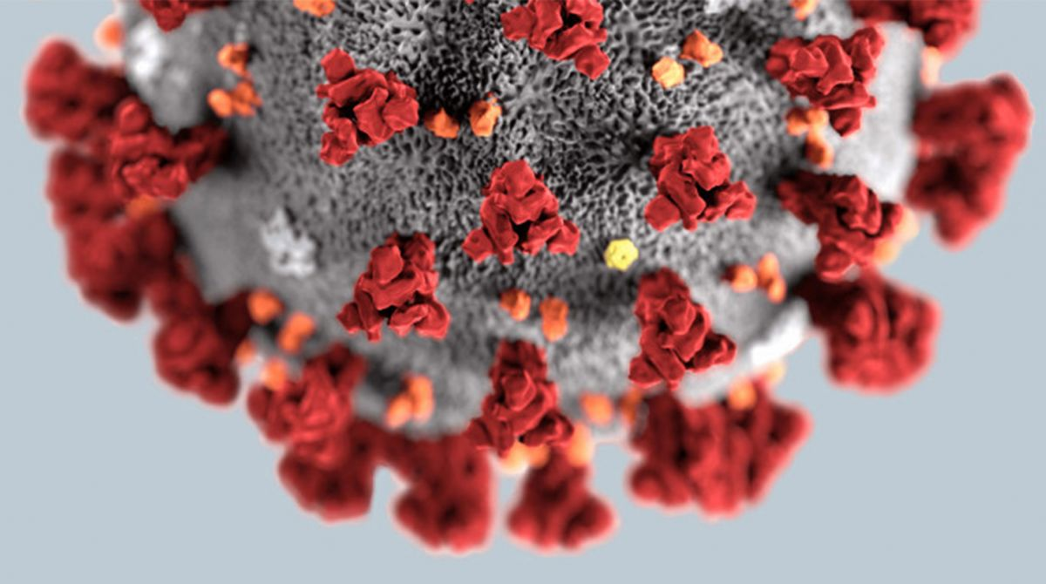

Slide 10
Covid 19
Challenges for Curriculum Delivery in the time of Covid-19
Reduced opportunities for Face to Face consulting
Challenges of Social Distancing
e.g. Spending time with a GP in their room being problematic
Risks of increased footfall in the Practice by someone from outside the clinical team
Limits on supply of PPE
Restrictions of time and focus of GP Tutor due to increased alternative demands
A poverty of authentic clinical encounters with actual patients
Uncertain Time Frame
May be part of the “ New Normal”
GP Consulting has changed …. Phone , Zoom , Accurx –Forever??? (We HOPE not)

Slide 11
Covid 19
Challenges for Curriculum Delivery in the time of Covid-19
Secondary Care Consulting has Also changed
Medical Schools Council (MSC) identified this as a Major Concern
G.M.C. state that our Students must have “A Clinical Experience”
Did not specify How….

Slide 12
Covid 19
GP Sub-Deanery Pilot
A regional support and coordination structure needed
Started in January 2020 under the FSU organisation
Proto GP Sub-Dean (Claire Loughrey)
Two pilot Federations (with GP Leads)
  North Belfast
  South-West Federation
Plan – set up structure for:
  Clinical Placements
  GP Tutor Support and Faculty development
  Primary Care education innovations
Covid came along

Slide 13
Covid 19
DoH / SUMDE Return to Clinical Placement Group
A group set-up to assess need for extra support for Clinical Placement delivery (Principally in the Trusts)
QUB GP submitted a bid for funding for (including):
  GP Clinical Facilitators (GPCF) – Year 4 & Year 5
  Webcam & Zoom Licences
  GP Technical Support officer
Lots of interest in GPCF role
  Regionalised
  Randomised
  Selected 9 GPCFs for each of year 4 and year 5

Slide 14
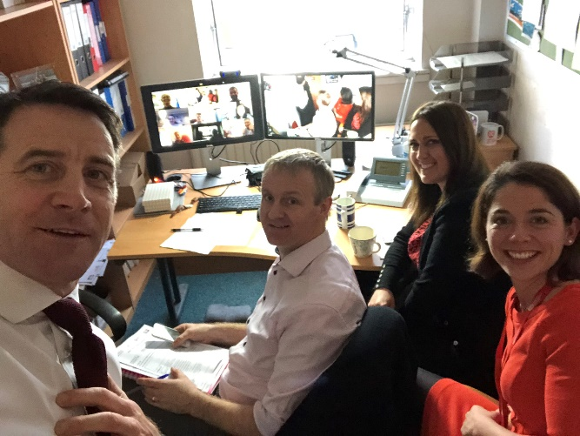
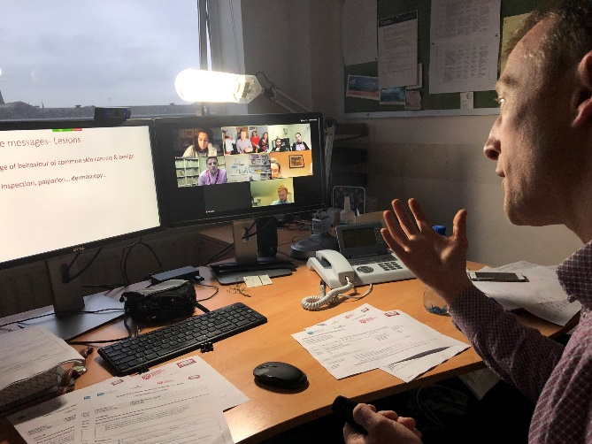
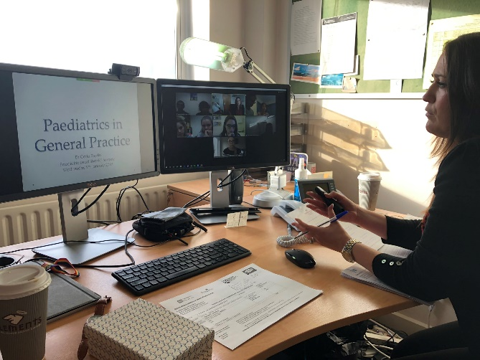
Previous experience of remote Clinical Case Discussion though our ECHO (Extension for Community Healthcare Outcomes) Pilots 2018-2020

Slide 15
Covid 19
GP Behind Closed Doors
“GP Behind Closed Doors” – Current TV programme Channel 5
Have Hundreds of Unedited GP Consultations Archived
Collaborative Project Between Medical School GP departments
  Watch, Tag & Label the consultations
MSC agreed to fund the production company (reportedly circa. £100K)
Distributed to Medical Schools around UK during August
QUB team did 5 of these

Slide 16
Covid 19
What was required…..
Each University responsible for “Tagging “ their Videos
Each Video has a Title for Tutor and Title for Student.
E.g Tutor “Lady with Hidradenitis and Skin Tags seeking Referral”
Student” Patient with Skin problems attends her GP”
Tagging highlights learning points , cues or clues.
“at 3minutes 40 seconds patient mentions Mother had Skin Cancer”
Thus a huge Library of GP Consultations-Tagged-is created

Slide 17
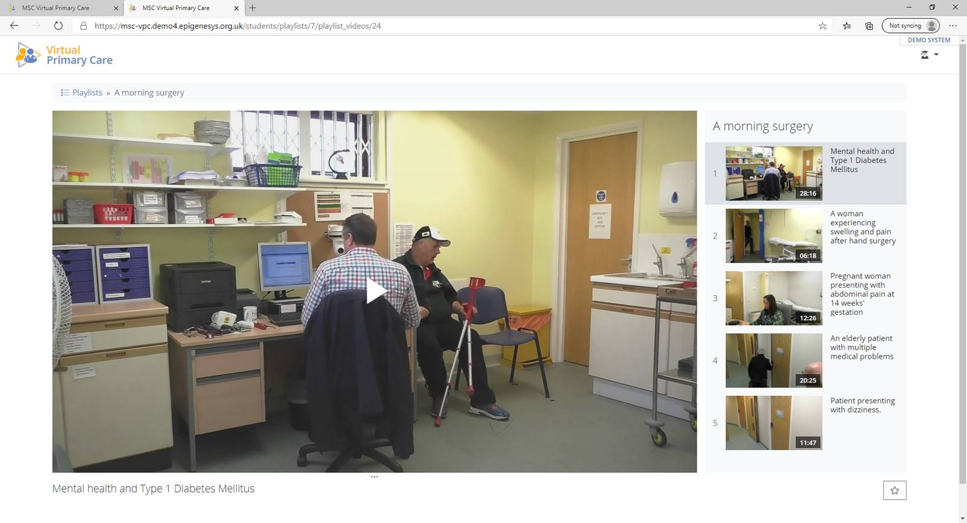
“Virtual Primary Care” – available 5th October 2020

Slide 18
Covid 19
Our Proposal…..
Case-based discussions
Lead by Experienced GP Tutors
Delivered to small groups 8-10 Students
Hopefully in a Clustered Area
1st and 2nd Wednesday Afternoons in each GP Attachment (Yr 4 & Yr5)
Planning for 2 Hours Maximum
Done over Zoom

Slide 19
Covid 19
Our Proposal…..contd.
Each Student assigned Tutor before going to Practice
Zoom meetings pre-arranged and links sent to Participants
IT Support (from QUB – hopefully IT Tech Support)
Use ‘Virtual Primary Care’ (VPC) Resource
Before each Meeting GPCF has paired up students to each watch 4 videos from VPC
Each one 10-20 Minutes long
Each pair to present their Video
  One from Patients Ideas Concern Expectations
  One from GPs perspective -Listening? Care? Getting it Right?
GPCF Lead the discussions?

Slide 20
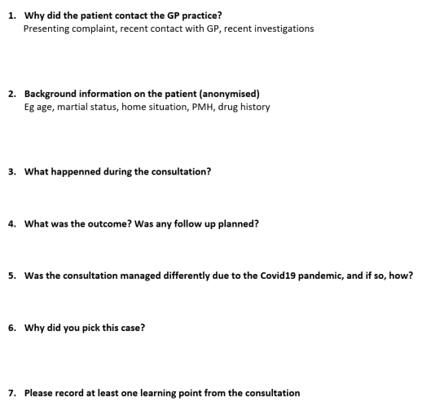
Covid 19
In the short term….
In advance of VPC coming online…ask students to get a case from their time in Practice

Slide 21
Covid 19
Our Proposal…..contd.
Signpost to Consultation Models
Balint , Neighbour , Calgary Cambridge.
Consultation Mapping?
Reminder on Professionalism, Confidentiality and Respect
Appreciation of how Challenging must have been for Patients to open up, as they do, on TV
Appreciation of how Brave our GP Colleagues are letting their workspace be Filmed
Zoom etiquette and cameras ON

Slide 22
Covid 19
Our Proposal…..contd.
Tutor teases out any parts of Consultation that the Student may have overlooked
Pendleton's rules of “FEEDBACK”
Opportunity to identify the Verbal/Non-Verbal cues
Opportunity to highlight “Typical” Consultation techniques
Obvious Learning opportunities on the Clinical Content of each video
Possibly to point out things that could have been done differently
100% Attendance- record any Absences

Slide 23
Covid 19
Our Proposal…..contd.
QUB Zoom licence
Session set-up centrally and all join and put out to break-out groups
VPC Platform will be available to all
Roles for GPCFs
  Picking cases?
  ‘Herding’ students and picking cases
  Ensure major learning points not missed
Equality and Diversity

Slide 24
Covid 19
The ECHO Proposal for Year 4
3rd Wednesday of 4th Year Attachment
3 Concurrent ECHOs (join two groups together)
15-18 Students
Joint-facilitation role
The ECHO
  @ Hub QUBGP member
  @ Spokes
    Secondary care “Expert”
    Students/GPCF
Students/GP Tutors/CF advised of what Presentation is on
Identify Real Cases in their Surgeries & submit these cases for presentation during the ECHO

Slide 25
Covid 19
The ECHO Proposal for Year 4…..contd.
Means 18 Videos per year – valuable learning resource
20-30 Minutes of didactic Presentation
Case Based Discussion is where Most learning occurs
We are ALL Learners and ALL Teachers
Try to Involve Everyone in the Spokes
Tele-Mentoring

