Slide 1
Family Medicine:
Modes of Consultation
Year 2
Centre for Medical Education
General Practice Experience – Year 2 Family Medicine
2020/2021

Slide 2
Aim of session
To introduce students to the traditional and newer modes of consultations open to GPs and other clinicans and consider their advantages and pitfalls

Slide 3
Background
Modes other than “Face to face” are not new
Triggers to broaden the modes include infection control and patient convenience
BUT Covid19 has accelerated their use throughout healthcare exponentially
General Practice has been quick to adopt and adapt
These quickly adapted modes are likely to remain beyond Covid19
Notes:
It is important to put this in context for the students
Remote consultations were widely used prior to Covid19 in countries with large rural populations e.g. Canada, Australia and in Scandinavia
Previous concerns about the capabilities of the technology has been largely and rapidly set aside
Many secondary care specialities took their lead from General Practice locally
Prof Martin Marshall of the RCGP has suggested that the split between remote/f2f contact could be 50:50 in the future

Slide 4
Where do consultations take place in Primary Care?
Notes:
I have left this blank deliberately, suggestion on next slide
This is an interactice moment and as per the teaching plan, you can decide whether you do this just by students chipping in on their mics, using the chat function or even breakout rooms if you are comfortable with this.

Slide 5
Where do consultations take place in Primary Care?
Notes:
Students might be slow to start and only mention the obvious – GP rooms, TR. Patient's own homes, OOH centres
I am sure you all have interesting places to add – the carpark outside the surgery, people's workplace on the phone, I was involved in a detention in a pub (at 11am), side of a pitch, what about cruise ships – you'll have lots to add to their list

Slide 6
Brainstorming the different modes
Notes:
I have left this blank deliberately, suggestion on next slide
As students suggest the different modes, you could ask if anyone had any experience of the modes other than F2F – if they wanted to share (no pressure clearly)

Slide 7
Brainstorming the different modes
Face to face
Telephone
Video
Online/text based

Slide 8
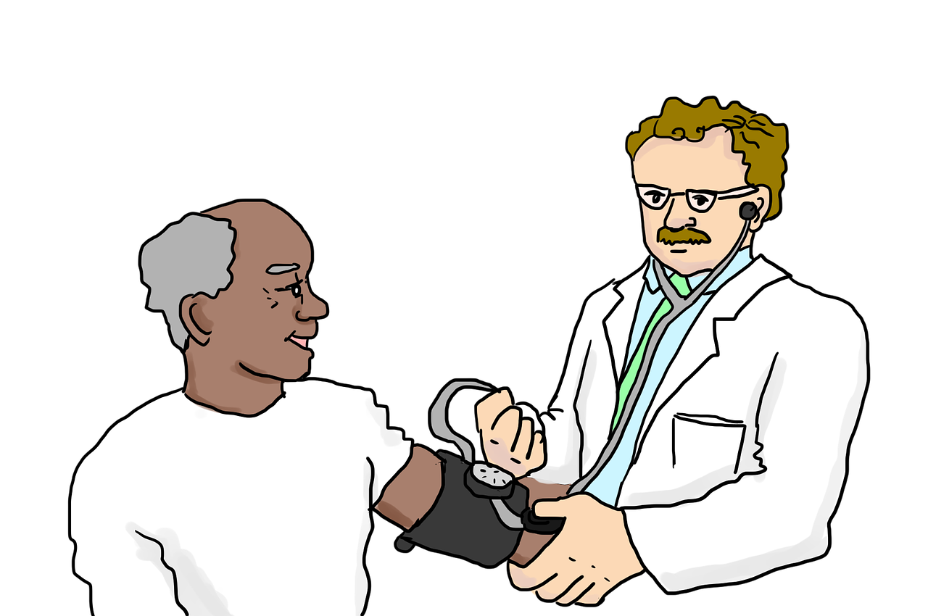
Face to face
Notes:
What they will be most familiar with
Might be worth mentioning how all these are currently done in PPE, which brings its own challenges for communication

Slide 9
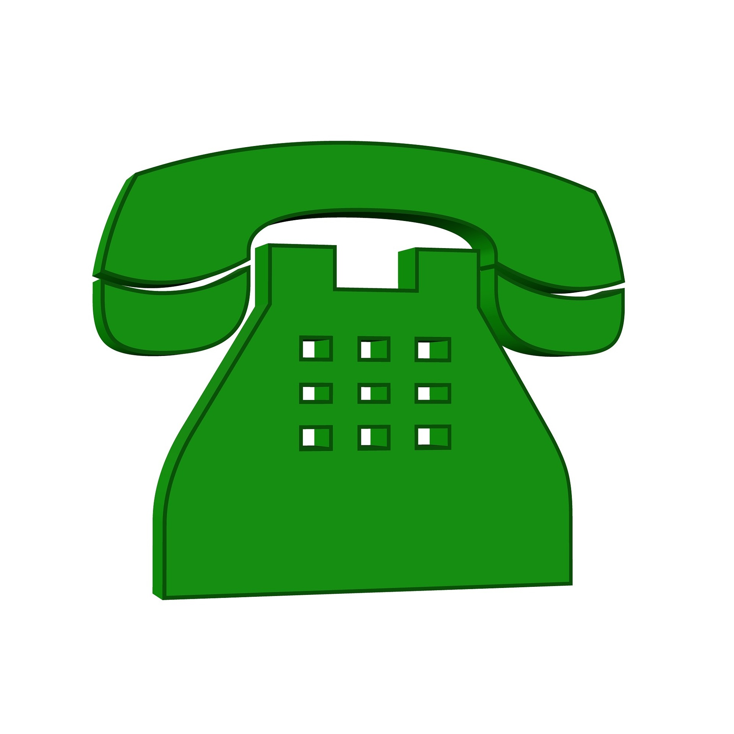
Telephone
Notes:
Showing my age with this telephone but it is to distinguish from video consultation on a smart phone!
Explain to the students how this works in your surgery and any anecdotes you have
Explain about “ask my GP” prior to Covid19
Would be good to discuss the different between telephone triage and telephone consults

Slide 10
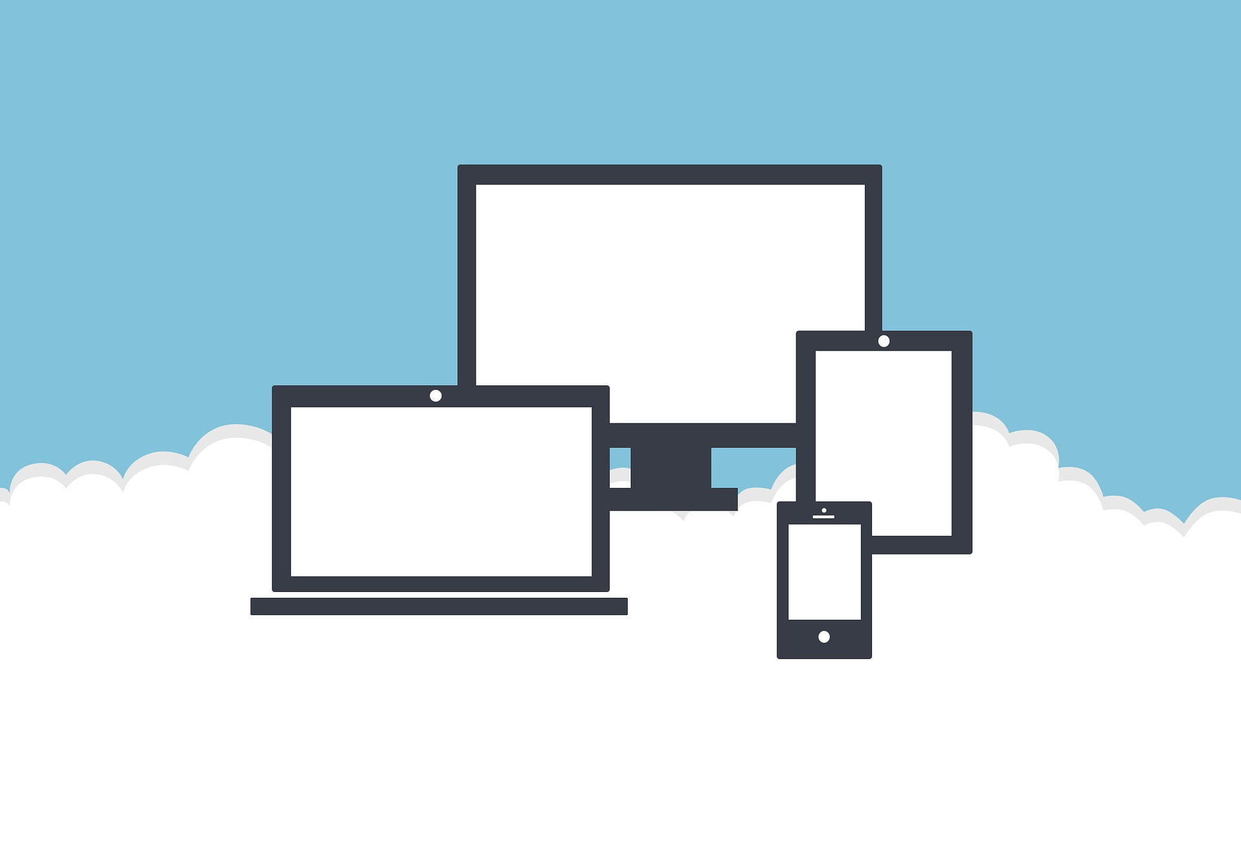
Video
Notes:
Explain to the students how this works in your surgery and any anecdotes you have
Including anything that happens outside real time e.g. sending pictures in AccuRx

Slide 11
‘Examining’ during video consultations
What can you observe e.g. colour
Could someone with the patient help e.g. describing their breathing, counting their resps
What about home obs e.g. home BP monitor
What about intimate or ‘semi-intimate’ examinations?
Need for a chaperone?
Notes:
Again, any examples that have of this will make it more real for the students
An example of a semi-intimate examination might be looking a lesion on a patient’s chest wall
The RCGP recommends using of a chaperone in remote consultations if you would use them in a face to face examination. The chaperone is to be with the practitioner, seeing what they see.

Slide 12
Advantages of remote consultations
Notes:
Again suggest doing interactively

Slide 13
Advantages of remote consultations
Convenience for many patients e.g. working patients
Infection control preserved
?better control for the GP on their workload
Notes:
Feel free to add

Slide 14
Pitfalls of remote consultations
Notes:
Again suggest doing interactively

Slide 15
Pitfalls of remote consultations
Technical aspects “You’re on mute”
Harder to establish rapport and trust
Confidentiality – who is in their room?
Privacy issues
Security issues
Limitations to examination
Are you being recorded?
Notes:
I could go on – feel free to add

Slide 16
Who might struggle most with remote consultations
Notes:
Again suggest doing interactively

Slide 17
Who might struggle most with remote consultations
Older people
People without access to the technology
People with mental health issues
People with learning disability
People requiring interpreters
People highly concerned with the privacy/security
Notes:
There might be some repetition with the previous discussion
It is arguably not equitable for all, ?truly free at the point of access? – this is worth discussing as students who have good health literacy may immediately consider those who do not

Slide 18
Safety netting in remote consultations
Even more important than in more traditional consultations
Think about what you might to record
Notes:
Give them clinical examples and ask what might need recorded
for example when you have decided not to see a child F2F
prescribed ABs over the phone

Slide 19
Family Attachment over Zoom?
Students to consider their Family Attachment experience from last year and how this might be different for current first years, who will be meeting their families over video conferencing …

Slide 20
Aim of session
To introduce students to the traditional and newer modes of consultations open to GPs and consider their advantages and pitfalls

