Slide 1

Zoom Q+As
CSEC Tutor Meeting
Sept 21st 2020

Slide 2
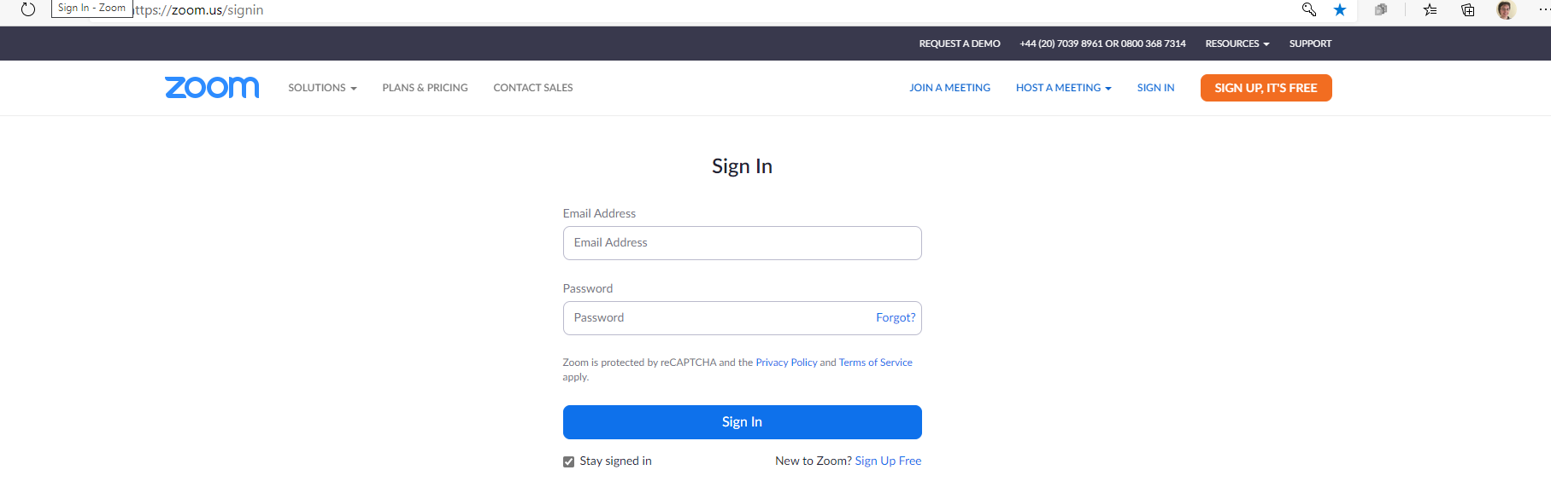
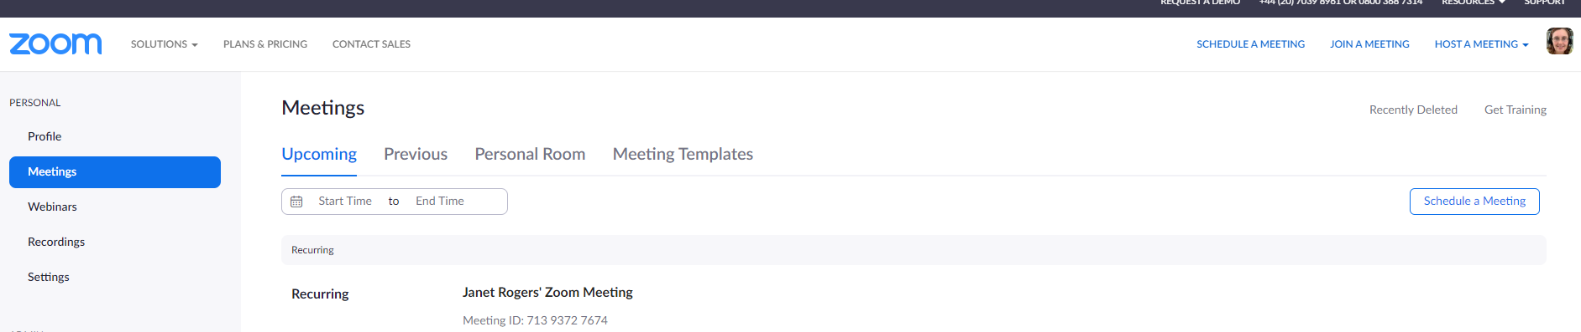
Start by opening Zoom on your web browser, https://zoom.us/ and sign into your account

Slide 3
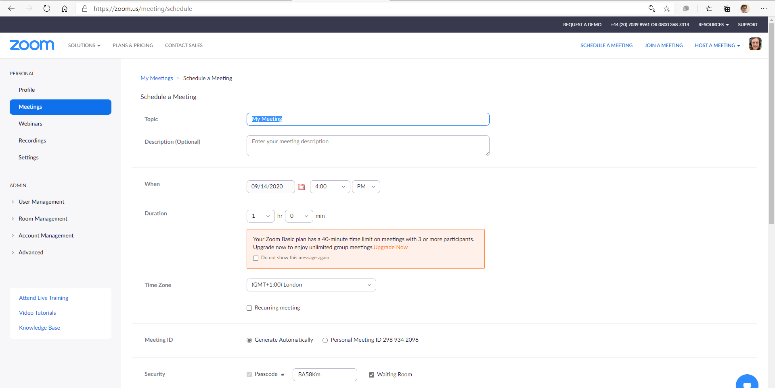
Zoom landing page, select Meetings to set up your 1st meeting
Check date and time selected
Appropriate for attachment teaching
Not for CSEC teaching

Slide 4
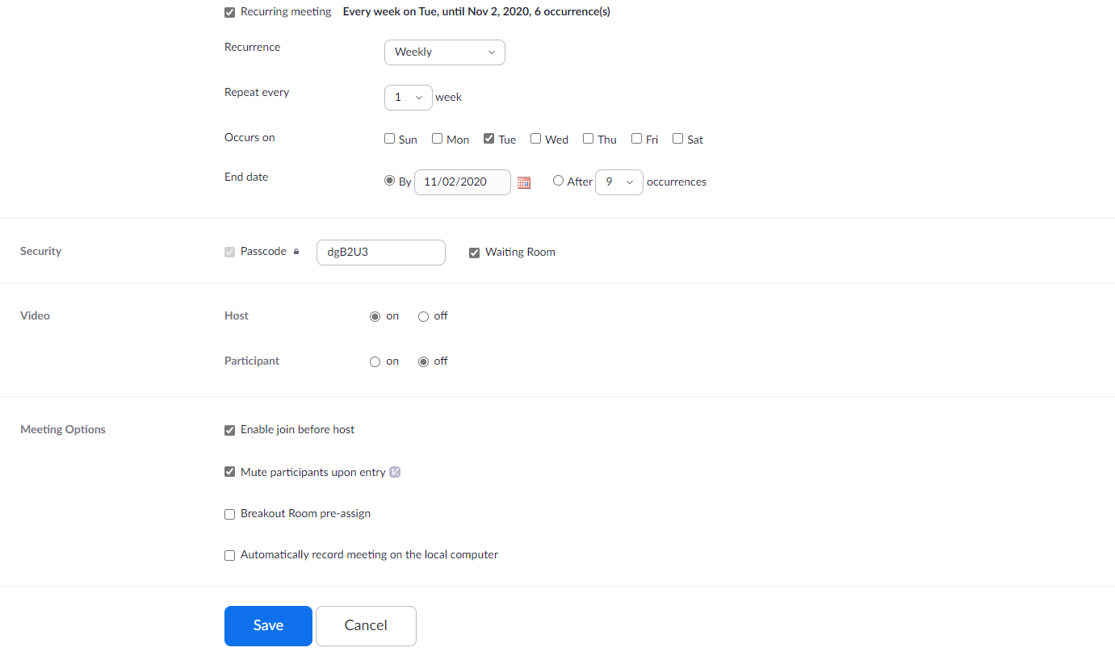
Settings for attachment teaching sessions, recurring meetings
Helpful settings but non-essential

Slide 5
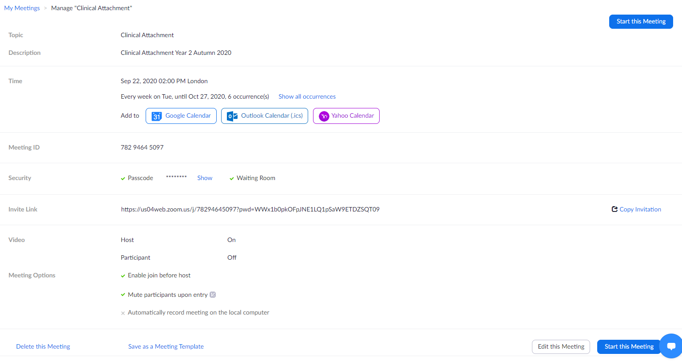
Confirmation of meeting with link for students to join
Copy this link to invite students by email
to the teaching session

Slide 6
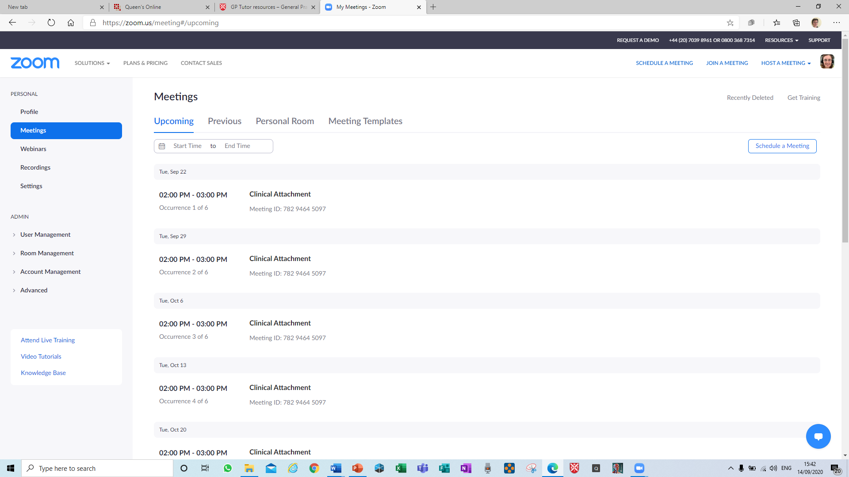
Summary of scheduled meetings
Schedule a new meeting from here

Slide 7
Recommended Settings for Teaching, Part 1. From Web Browser
If something isn’t working as it should, check your Settings in the web browser once signed into your Zoom account https://zoom.us/profile/setting, left side of screen. There are 57 settings in total, but some are more important, especially when setting up for the 1st. Ensure these are turned on / selected, then fine tune as time goes on
List of settings covered in Part 1
Waiting room
Host video, Participants video
Audio
Chat
Share files
Share video

Slide 8
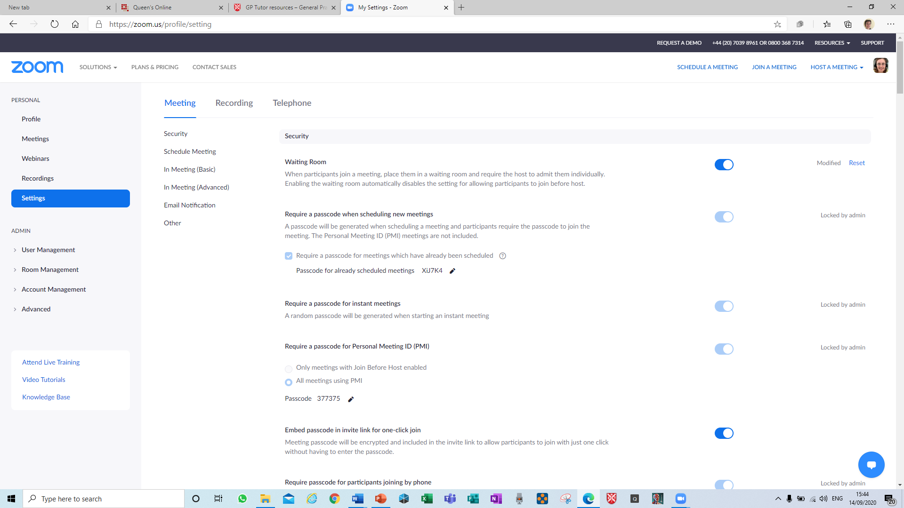
Recommended Settings for Teaching: 1. Waiting Room

Slide 9
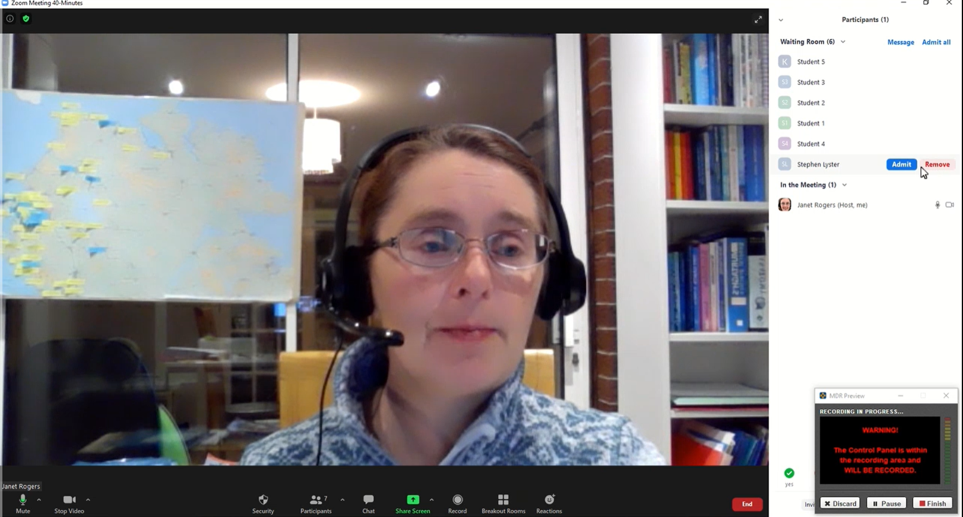
Teacher’s view as students arrive in waiting room
Select Admit
for each student

Slide 10
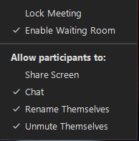
Admitting students to your Zoom tutorial from waiting room
Print a list of names and emails of students expected, to identify correct attendees (and back up attendance register)
Admit these students from the waiting room when ready
Optional -Lock the session once all students have “arrived”

Slide 11
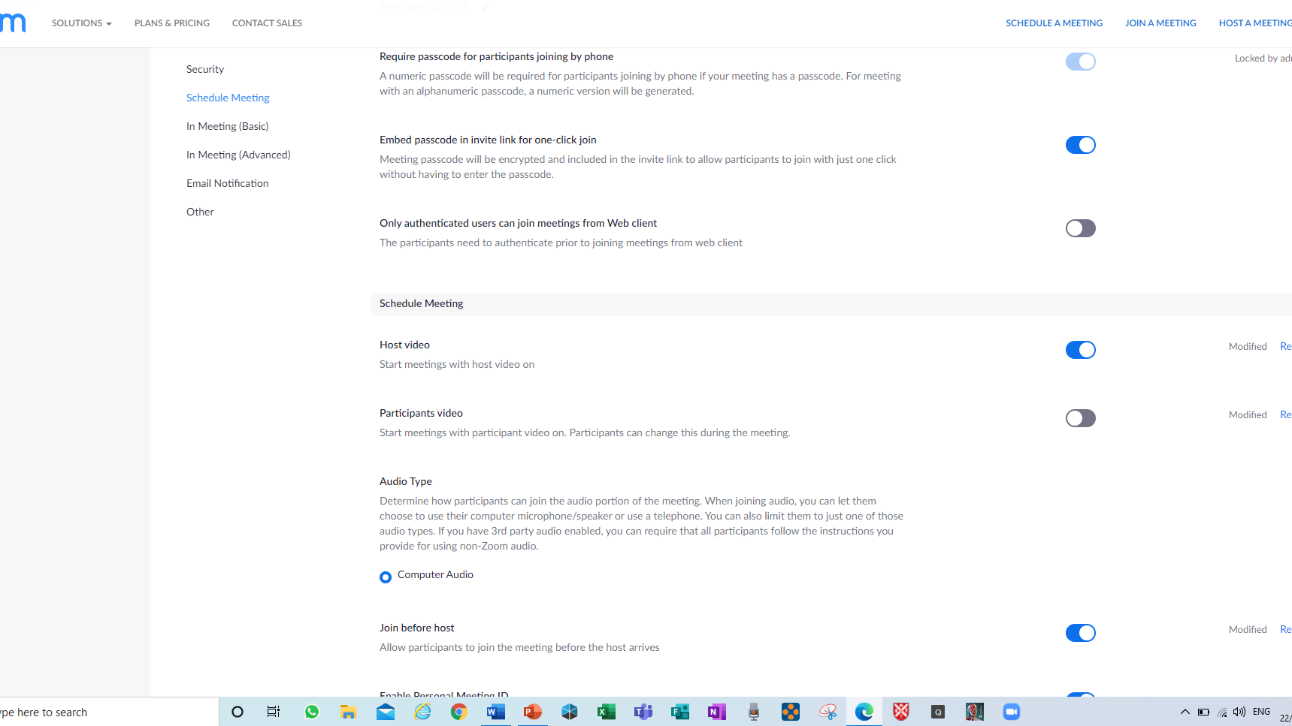
Recommended Settings for Teaching:
2. Host Video, Participants Video

Slide 12
Recommended Settings for Teaching:
3. Audio
Select “Telephone and computer
audio” if listed to enable students
to participate by phone only

Slide 13
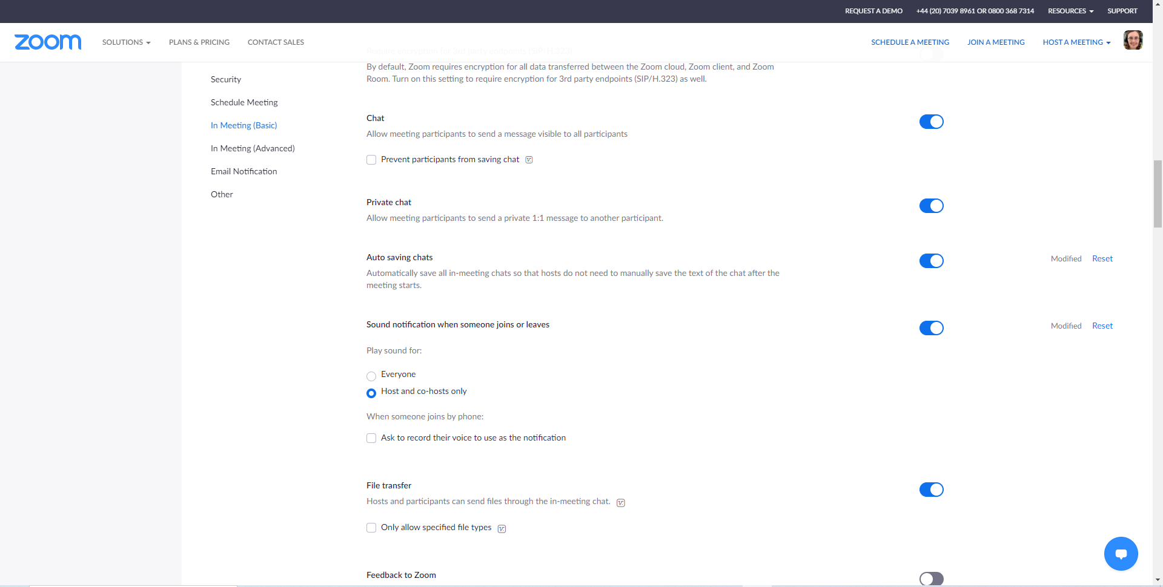
Recommended Settings for Teaching:
4. Chat

Slide 14
Recommended Settings for Teaching:
5. Share files

Slide 15
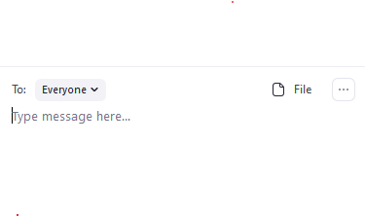
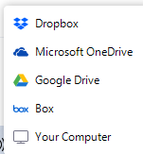
Recommended Settings for Teaching:
5. Share files, meeting view in chat, bottom right
Options available

Slide 16
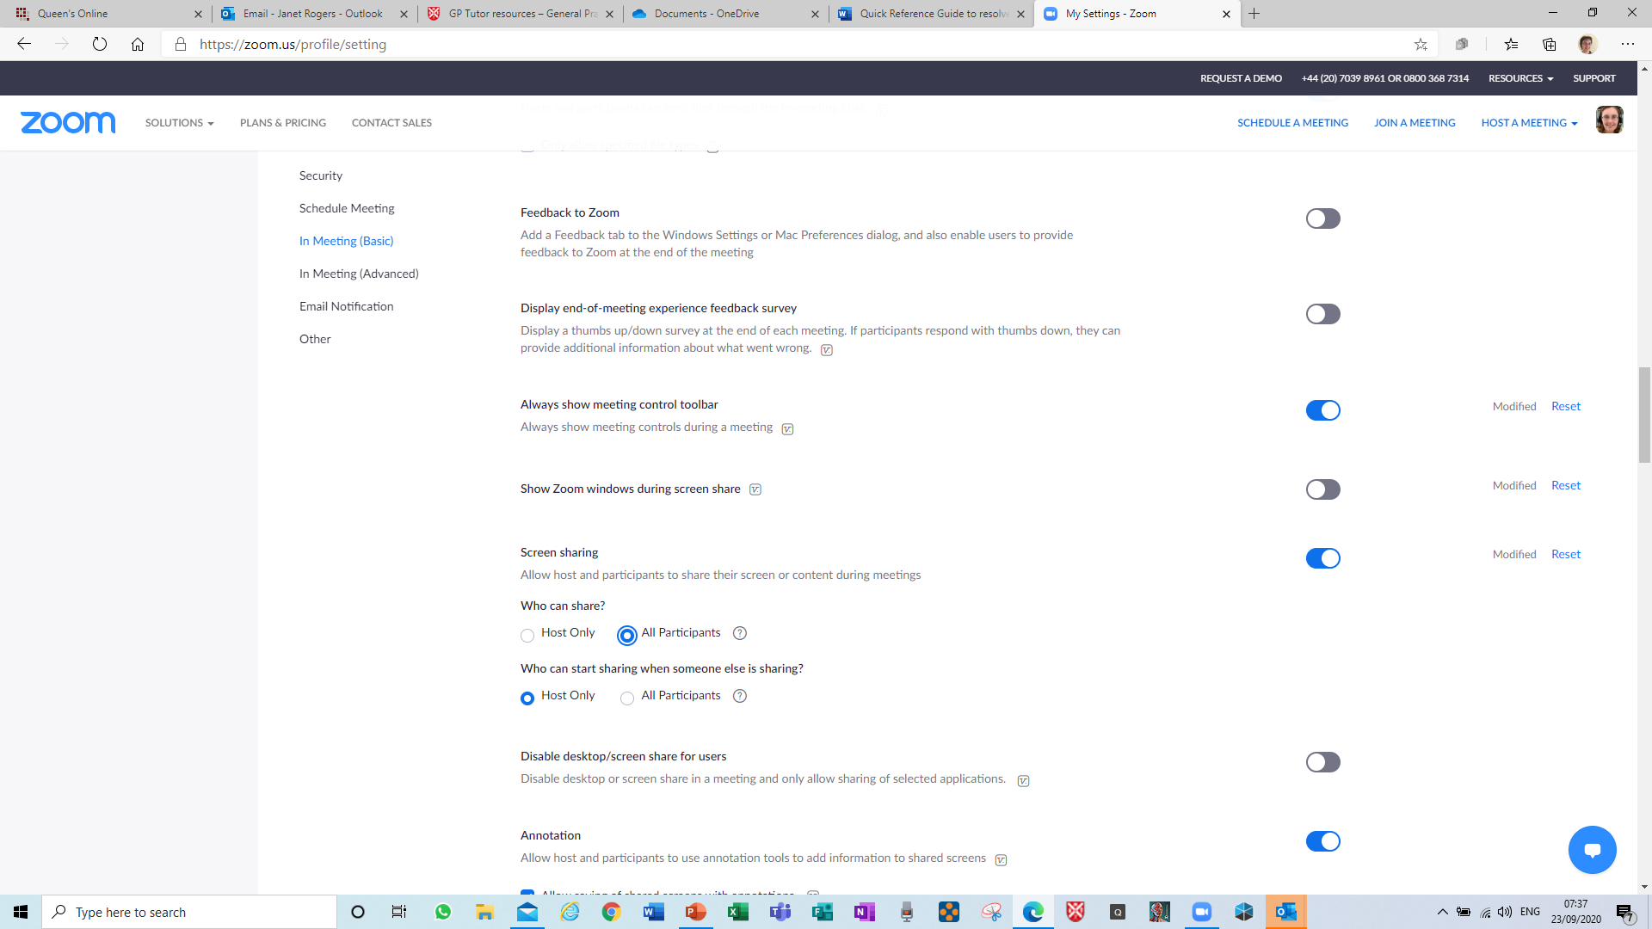
Recommended settings for Teaching
6. Share video
Enable all students
to share videos

Slide 17
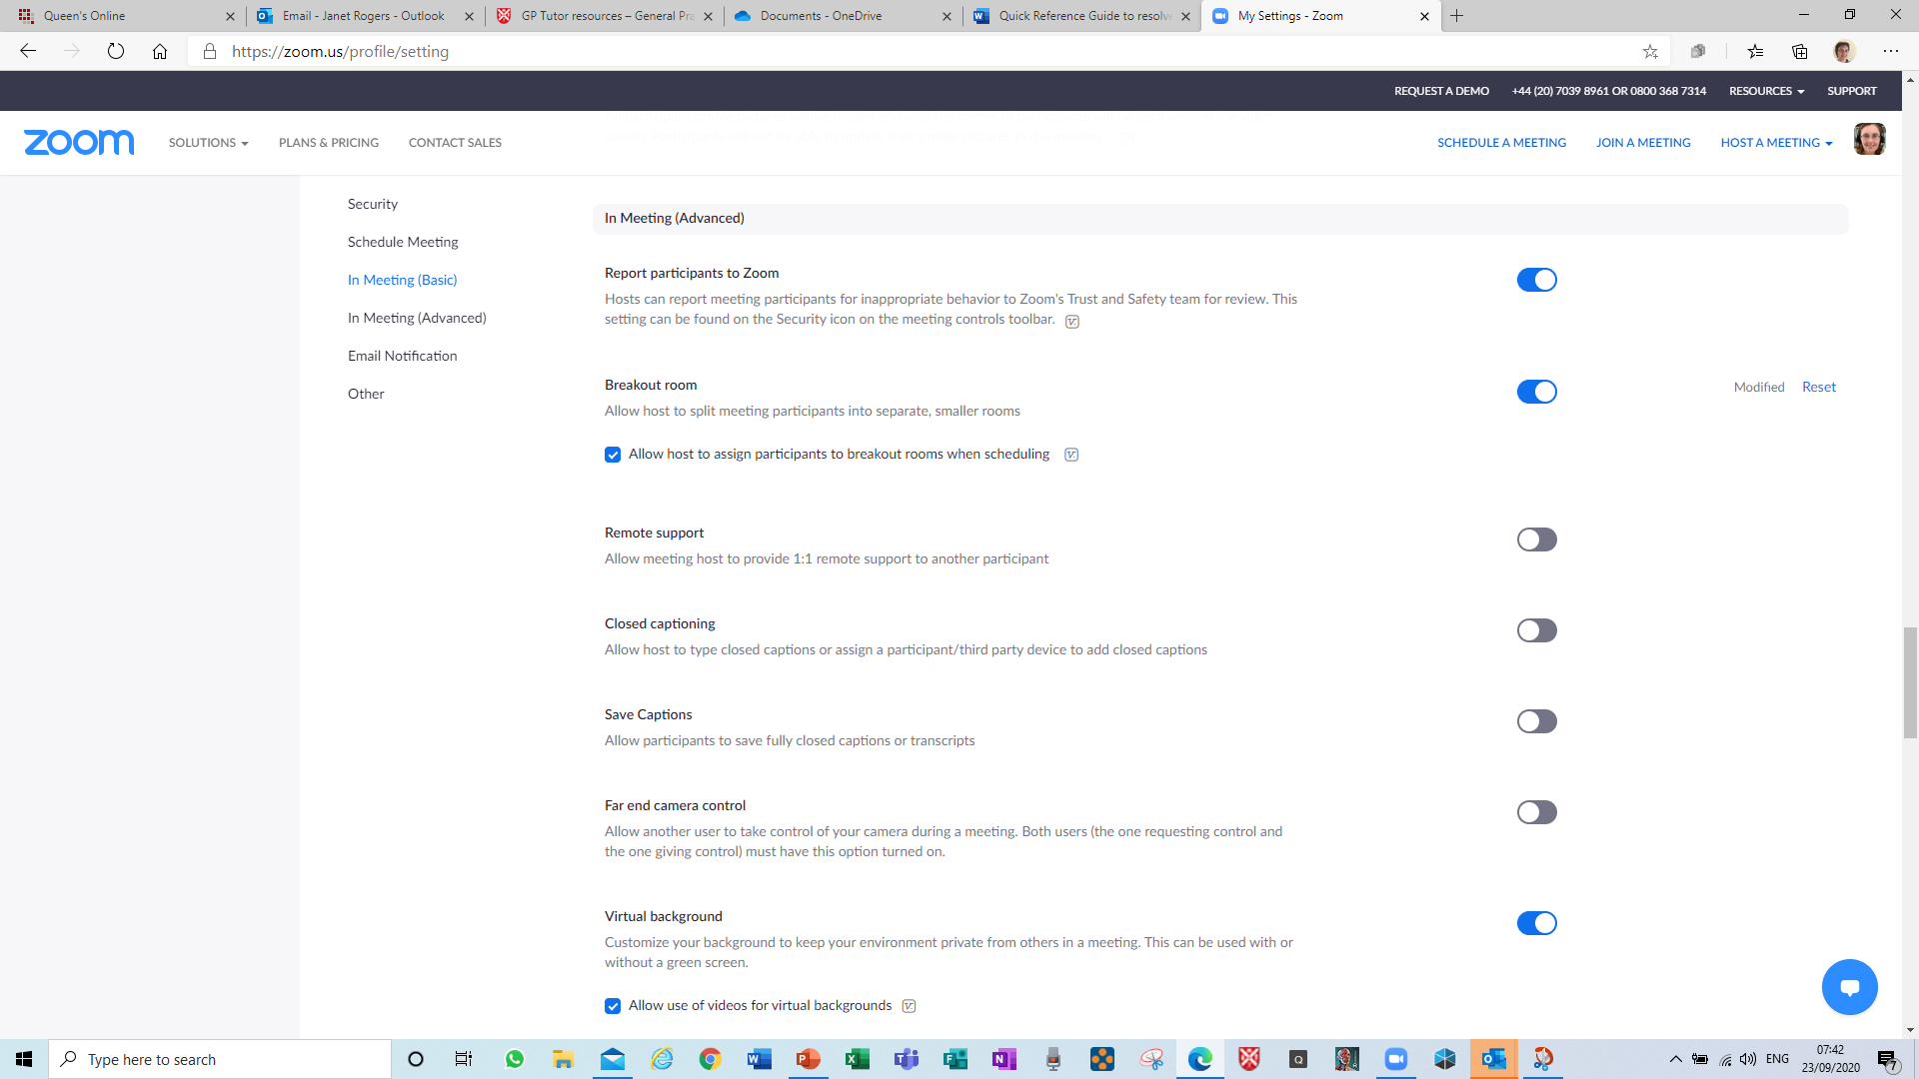
Recommended settings for Teaching
7. Breakout Rooms
If you wish to use
breakout rooms, this
must 1st be enabled in
Settings on web browser
Zoom site

Slide 18
Settings for breakout rooms
Breakout room - on in Zoom settings as above
This enables control of breakout rooms during meetings, and turns on this option on meeting control panel

Slide 19
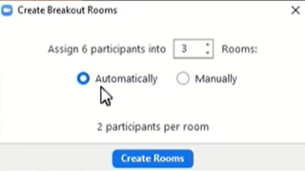
Teacher view dialogue box

Slide 20
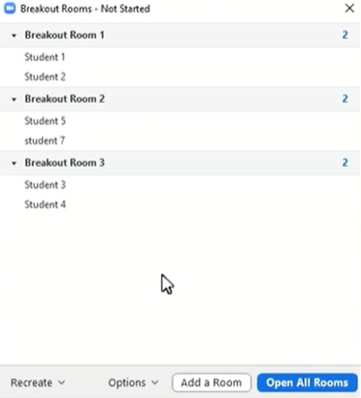
Teacher view dialogue box

Slide 21
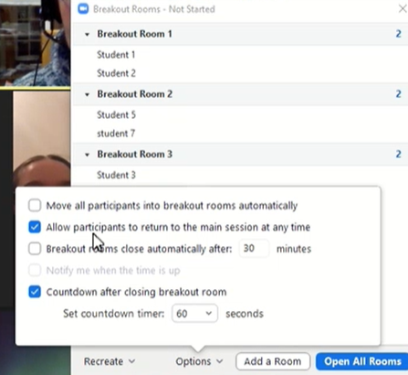
Teacher view dialogue box

Slide 22
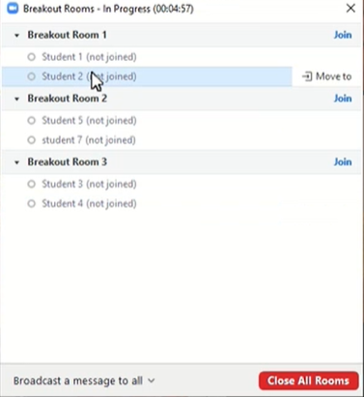
Teacher view dialogue box

Slide 23
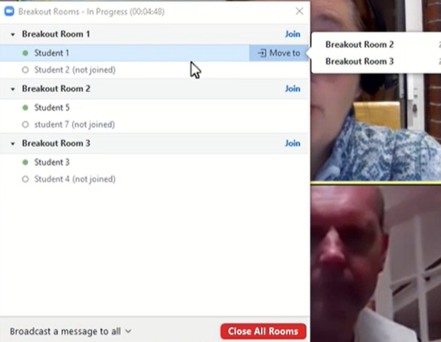
Teacher view dialogue box

Slide 24
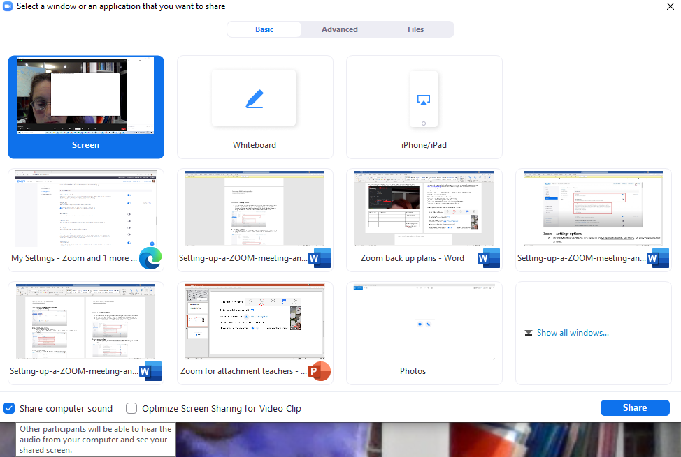
Settings for screen sharing – sharing sound, teacher view
To share sound from any videos being shared, it’s essential to click on Share computer sound after opening the Share Screen. This applies to you and for any students sharing

Slide 25
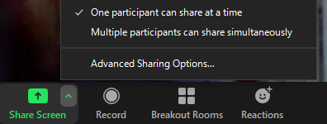
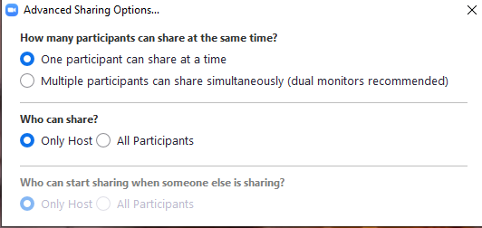
Settings for screen sharing
Go to share screen, select advanced sharing options
These should be the preset options; adjust
to match if required

Slide 26
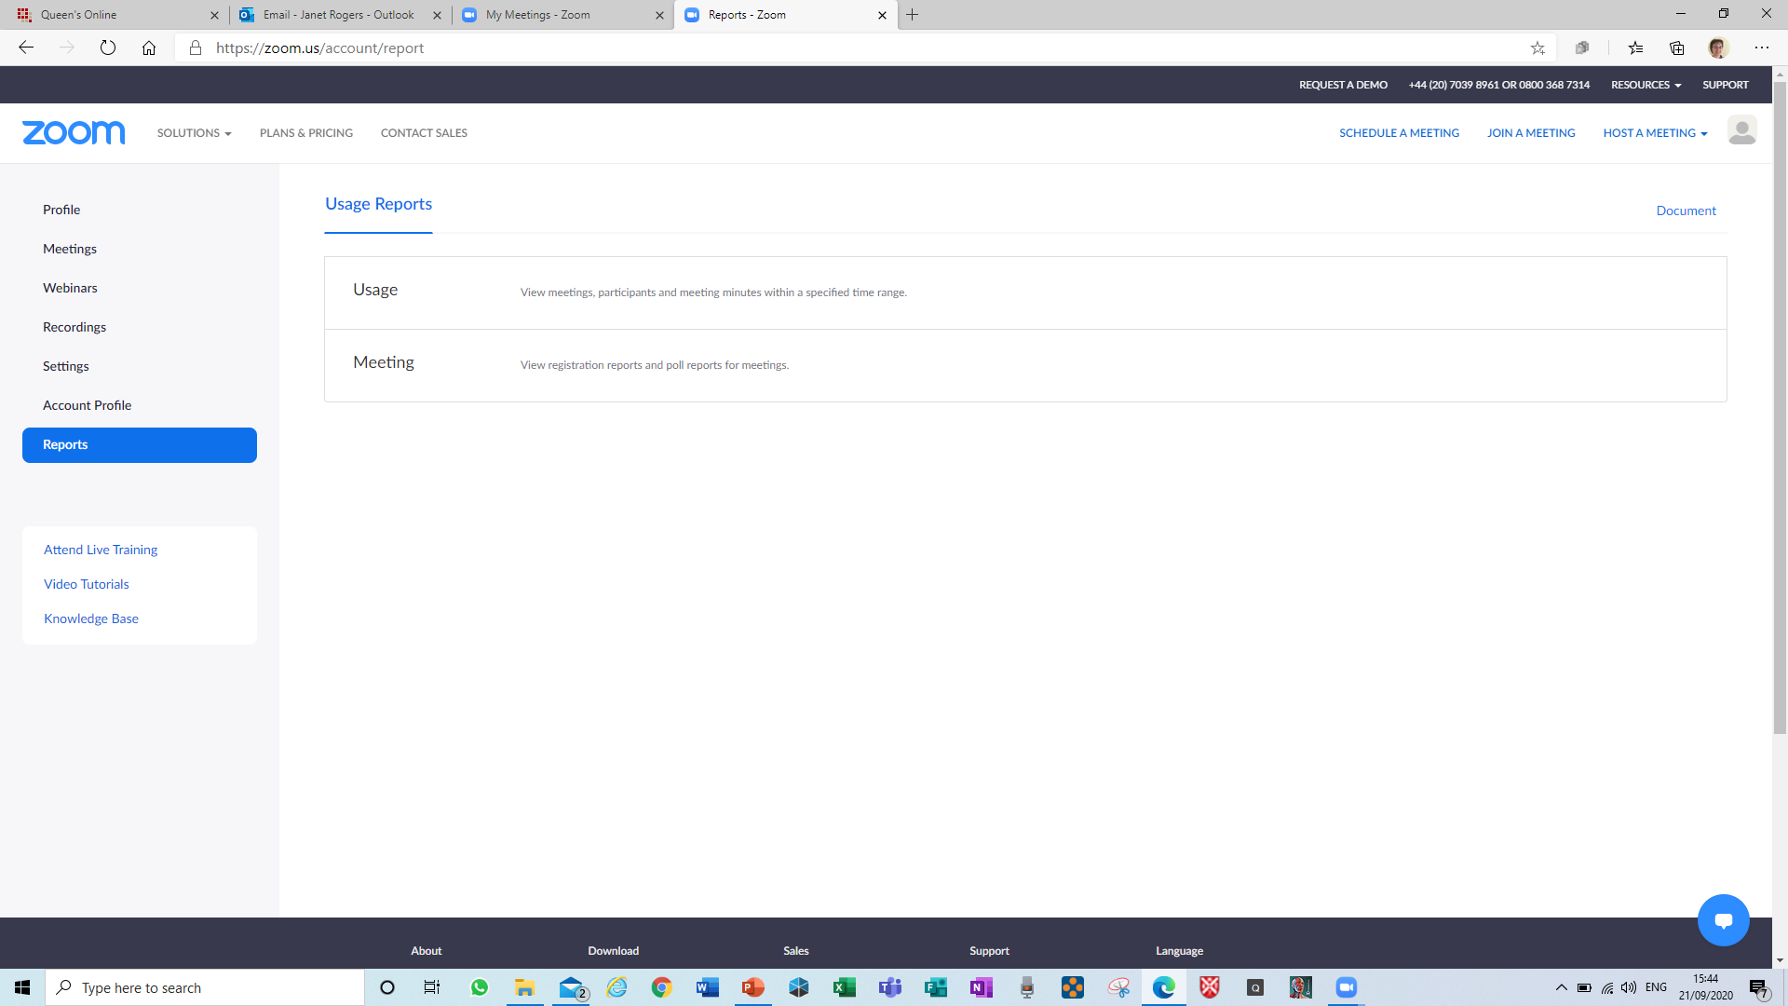
And finally, creating an attendance report

Slide 27
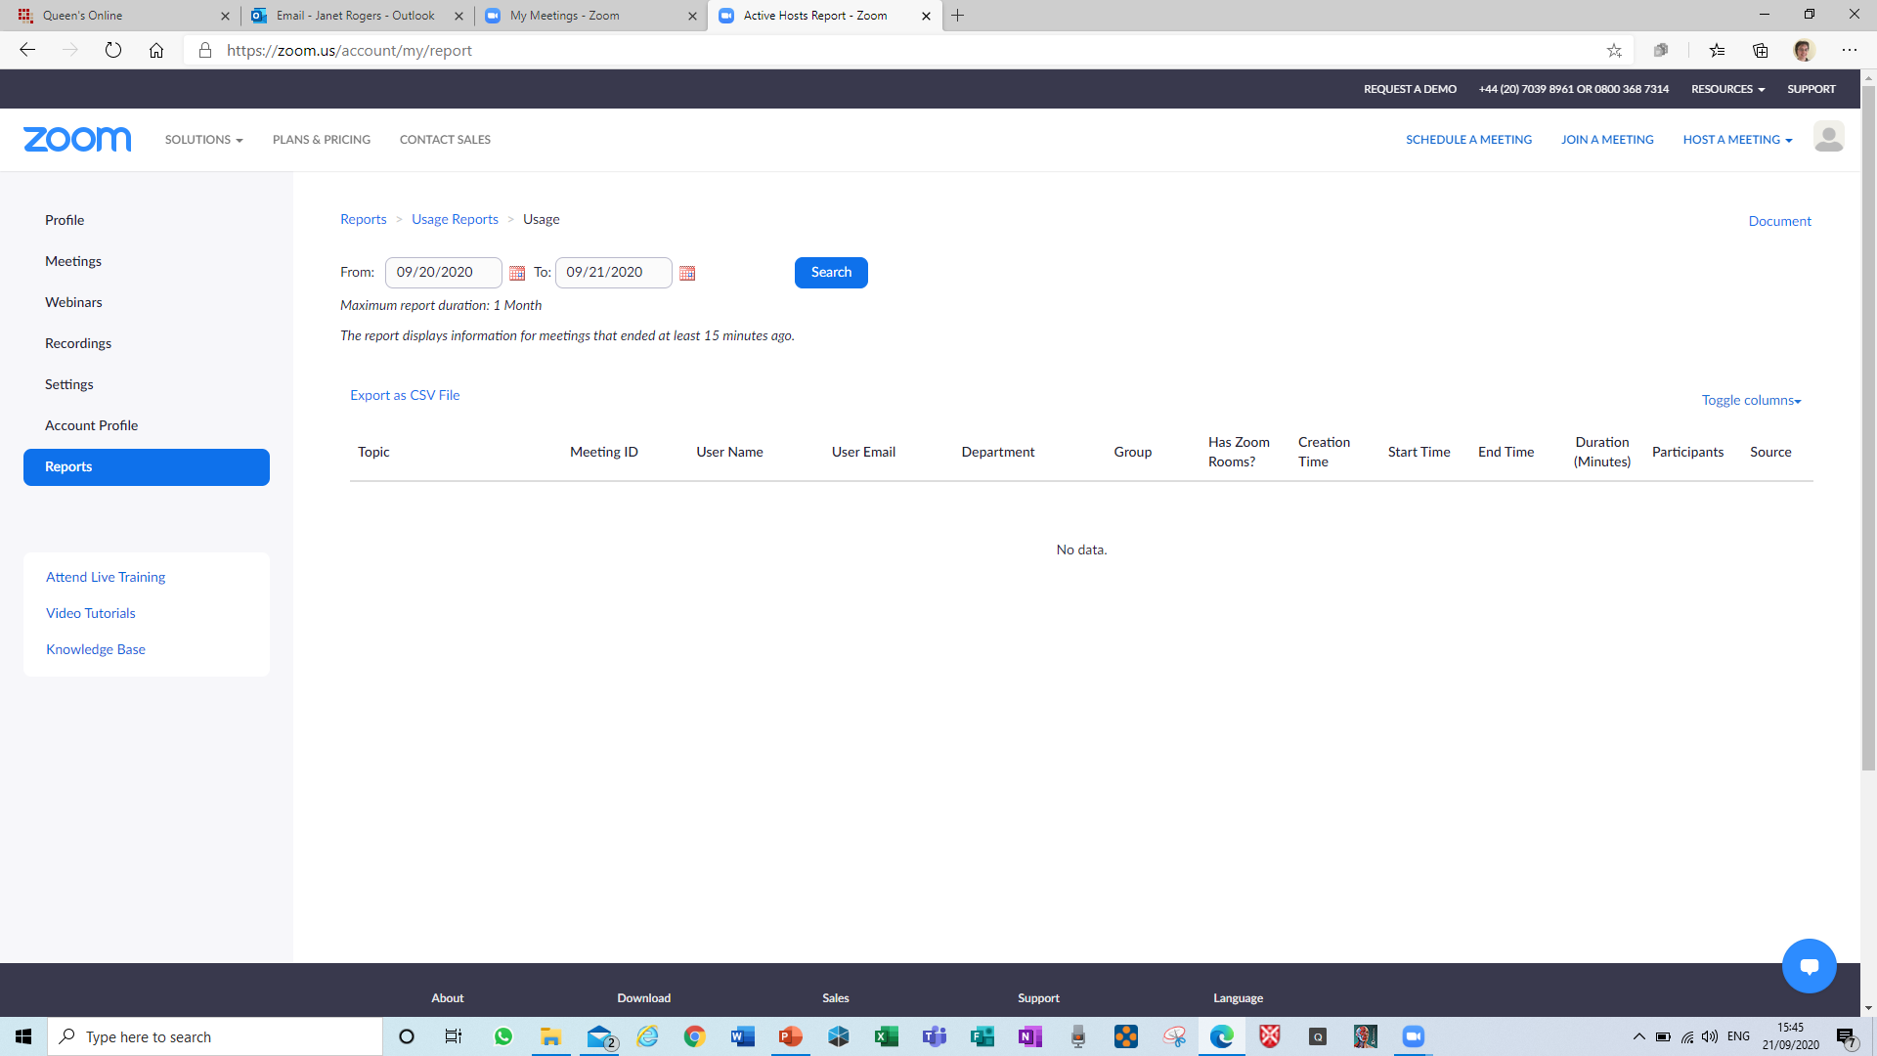
Recording attendance using Zoom
Pending clarification, see updated powerpoint slides at
https://onedrive.live.com/edit.aspx?cid=c287fbaceee7082a&page=view&resid=C287FBACEEE7082A!6277&parId=C287FBACEEE7082A!112&app=PowerPoint

Slide 28
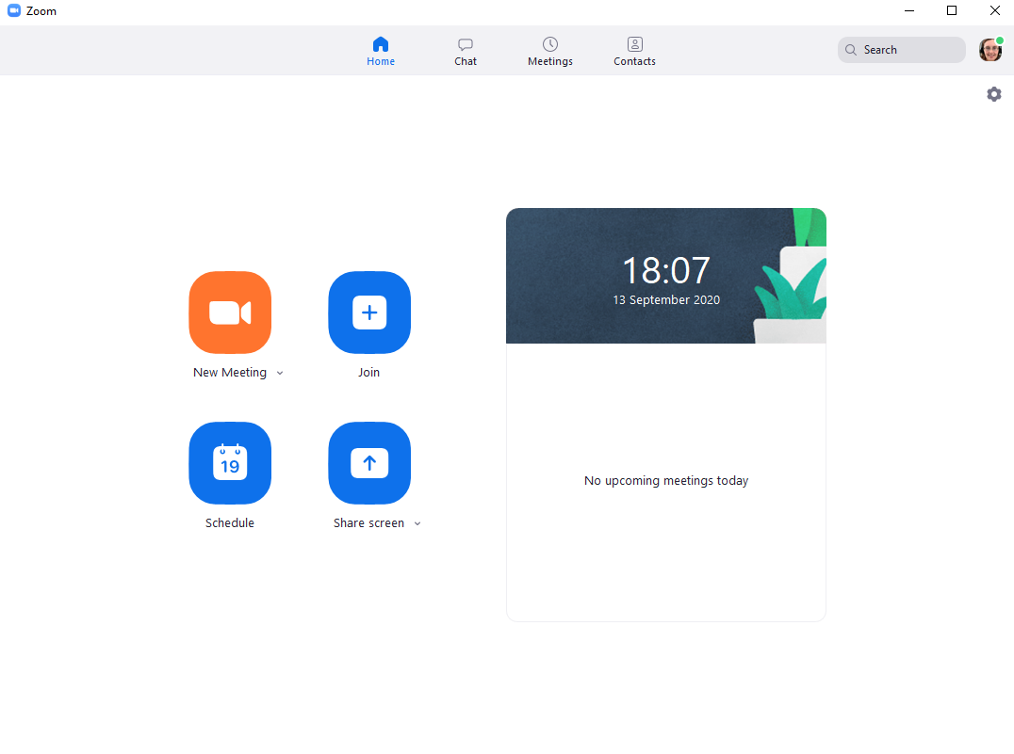
Zoom app for Windows or Mac
This may be a preferable way to use Zoom after pre-selecting settings in the browser webpage 1st
and is quick to download

Slide 29
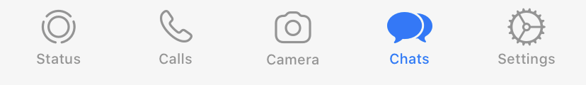
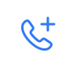
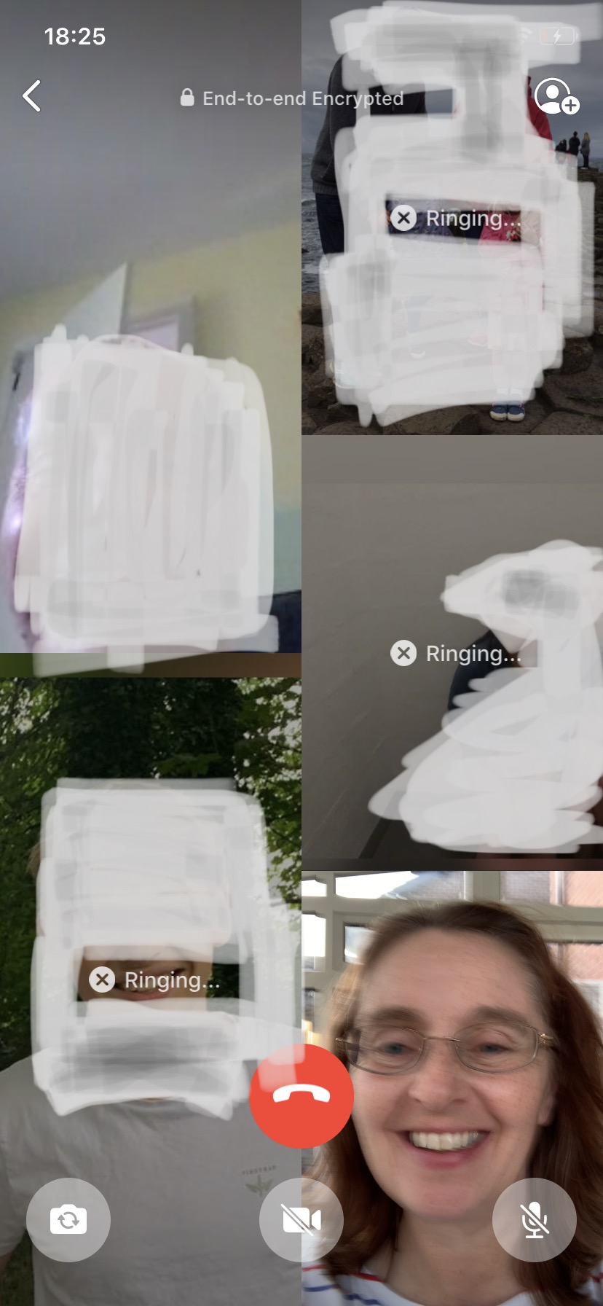
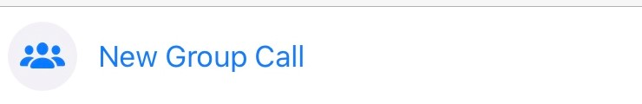
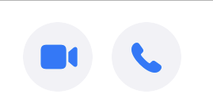
Alternative video conference if Zoom fails
Go to calls on Whatsapp
Go to Make Call icon, top right
Select New Group Call
Select names from stored contacts (limit is 7)
Chose video or phone option
View students on phone screen

Slide 30
Quick Reference Guide
To cover zoom log in
Starting meetings
Attendance recording
Troubleshooting

Slide 31

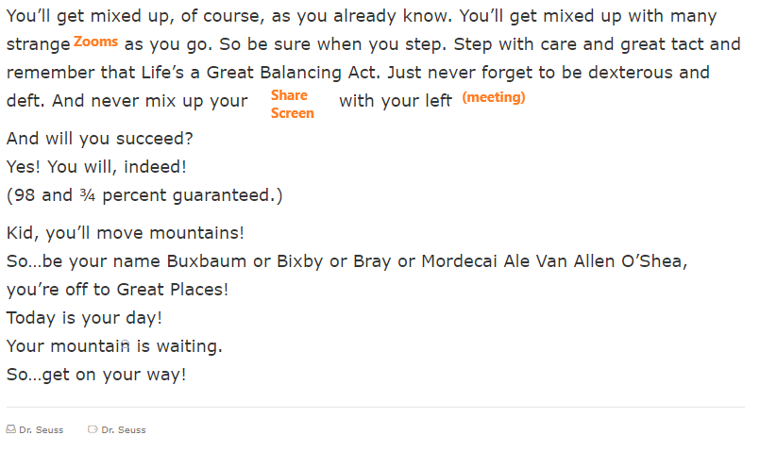

From Dr Seuss, Oh the places you’ll go…

