Slide 1


Welcome
Brexit and its implications
QUB & Ipsos MORI
Wifi name:
Wifi password:
MeeToo ID: 130-000-480

Slide 2
Fiona Rooney
Ipsos MORI Northern Ireland
Welcome
Housekeeping
  Toilets
  Fire exits
  Refreshments
  No mobile phones
Structure of the day
  Confidentiality and anonymity
  Your role today

Slide 3
Professor John Garry
Queens University Belfast
Thank you for coming along today!
Academic research project led by Queen’s University
Funded by the Economic and Social Research Council
What are the views and opinions of people in Northern Ireland?
Aim to discuss issues relating to UK’s decision at the referendum to leave the EU
Dr Kevin McNicholl: Northern Ireland, Brexit and Border issues
Professor Brendan O’Leary: The Constitutional Implications of the UK’s Vote to Leave the EU
After each presentation there is discussion around the table
Hope you find the day interesting and enjoyable!
Over to Kevin…

Slide 4
Northern Ireland, Brexit
and border issues
Kevin McNicholl

Slide 5
Five questions
1. What are the possible outcomes of the Brexit negotiations?
2. What impact do these possible outcomes have on…
    The border between Northern Ireland and the Republic of Ireland?
    A possible border between Northern Ireland and Great Britain?
3. Attitudes towards possible border checks?
4. What possible types of protest could there be?
5. How much support, if any, might there be for such protests?
Notes:
IMAGE INSTRUCTIONS
Insert the background image as a picture.
Move, resize and crop the image to fill the entire page. As you do this, ensure the focus of your image is well positioned, ideally to the right hand side of the page.
Cut the image to the clipboard.
Right-click on the page and select Format Background.
From the Fill menu click the Picture or texture fill option and then select Clipboard. Click Close.
Go to the second part of this document to select the suitable Graphic Device for the image.
GRAPHIC DEVICE INSTRUCTIONS
Paste the Graphic Device you selected into the page.
Move and resize the circles over the points of focus in your image. Move as many circles as required to create a pleasing sense of movement.
Circles can also be resized by grabbing a corner control point. They all have their aspect ratios locked, so will resize as circles.
DO NOT delete lines or circles.
DO NOT allow the lines between the circles to cross.
Select the black or grey border and change this to match the colour of the bottom border, using colours 3, 6 or 7 in the palette.
SAVING THE FINAL IMAGE
Go to the File\Save As menu option.
Browse to your job folder and in the Save as type drop down select JPEG.
Click Save and select Current Slide Only.
The image is now ready to import into your final document.

Slide 6
Possible outcomes of the Brexit process
UK leaves EU
UK leaves EU, but stays in some elements of the EU such as the Single Market and/or Customs Union
Great Britain leaves EU, but Northern Ireland stays in some elements of the EU such as the Single Market and/or Customs Union
Great Britain leaves EU, but Northern Ireland stays in EU
UK as a whole stays in the EU
Notes:
IMAGE INSTRUCTIONS
Insert the background image as a picture.
Move, resize and crop the image to fill the entire page. As you do this, ensure the focus of your image is well positioned, ideally to the right hand side of the page.
Cut the image to the clipboard.
Right-click on the page and select Format Background.
From the Fill menu click the Picture or texture fill option and then select Clipboard. Click Close.
Go to the second part of this document to select the suitable Graphic Device for the image.
GRAPHIC DEVICE INSTRUCTIONS
Paste the Graphic Device you selected into the page.
Move and resize the circles over the points of focus in your image. Move as many circles as required to create a pleasing sense of movement.
Circles can also be resized by grabbing a corner control point. They all have their aspect ratios locked, so will resize as circles.
DO NOT delete lines or circles.
DO NOT allow the lines between the circles to cross.
Select the black or grey border and change this to match the colour of the bottom border, using colours 3, 6 or 7 in the palette.
SAVING THE FINAL IMAGE
Go to the File\Save As menu option.
Browse to your job folder and in the Save as type drop down select JPEG.
Click Save and select Current Slide Only.
The image is now ready to import into your final document.

Slide 7
Border implications of each of these possible outcomes…?

Slide 8
A. UK leaves EU
This will put constraints on:
  the free movement of people from the EU to the UK
  the free movement of goods from the EU to the UK
The UK/Ireland border will be the UK’s land border with the EU
Three different possible implications for North-South border…
Notes:
IMAGE INSTRUCTIONS
Insert the background image as a picture.
Move, resize and crop the image to fill the entire page. As you do this, ensure the focus of your image is well positioned, ideally to the right hand side of the page.
Cut the image to the clipboard.
Right-click on the page and select Format Background.
From the Fill menu click the Picture or texture fill option and then select Clipboard. Click Close.
Go to the second part of this document to select the suitable Graphic Device for the image.
GRAPHIC DEVICE INSTRUCTIONS
Paste the Graphic Device you selected into the page.
Move and resize the circles over the points of focus in your image. Move as many circles as required to create a pleasing sense of movement.
Circles can also be resized by grabbing a corner control point. They all have their aspect ratios locked, so will resize as circles.
DO NOT delete lines or circles.
DO NOT allow the lines between the circles to cross.
Select the black or grey border and change this to match the colour of the bottom border, using colours 3, 6 or 7 in the palette.
SAVING THE FINAL IMAGE
Go to the File\Save As menu option.
Browse to your job folder and in the Save as type drop down select JPEG.
Click Save and select Current Slide Only.
The image is now ready to import into your final document.

Slide 9
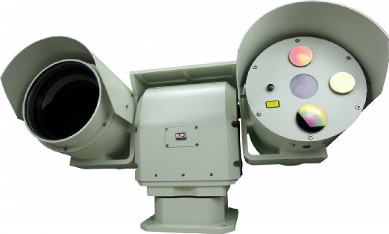
A1: low visibility, North-South border
using technology

Slide 10
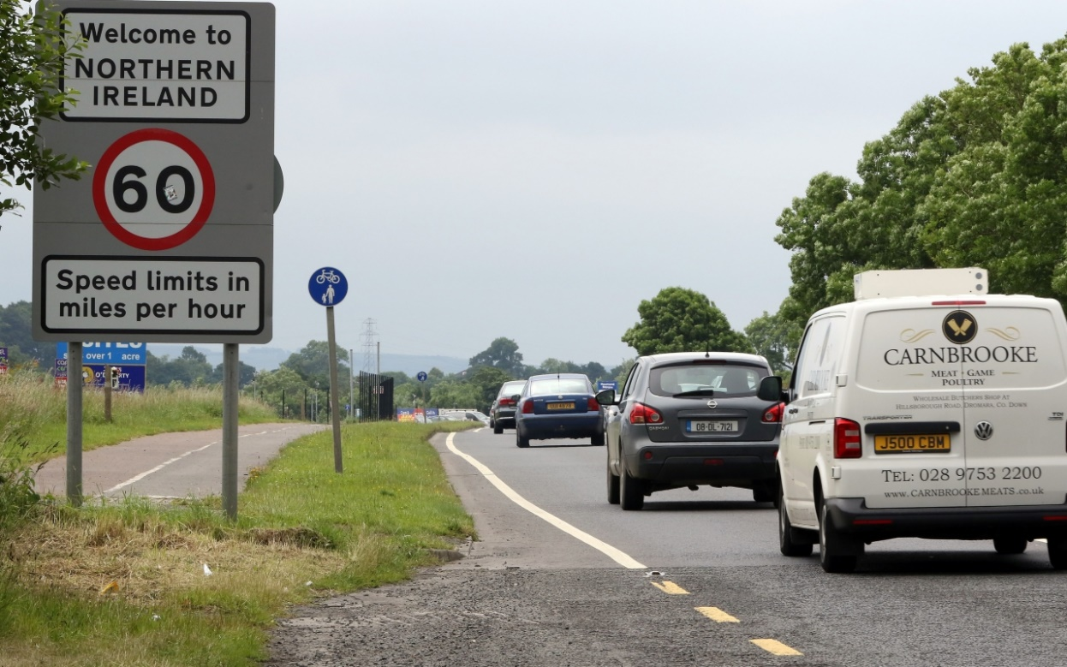
A2: North-South border with
minimal policing

Slide 11
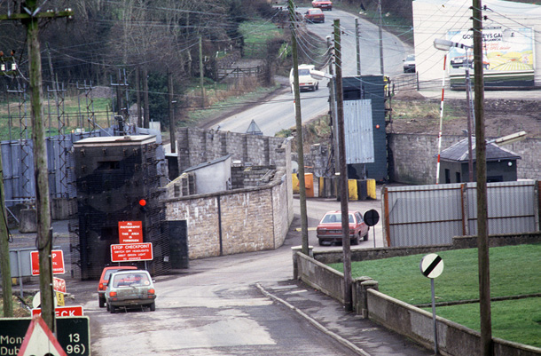
A3: Highly visible militarised
North-South border

Slide 12
The Customs Union & Single Market
The Customs Union
Contains all EU members, and some other countries
Goods moving between these countries are not taxed
Members taxes goods from outside the EU at the same rate
The Single Market
Contains all EU members, and some other countries
Requires free movement of people, goods, capital, and services
Also requires uniformity of standards of goods
Notes:
IMAGE INSTRUCTIONS
Insert the background image as a picture.
Move, resize and crop the image to fill the entire page. As you do this, ensure the focus of your image is well positioned, ideally to the right hand side of the page.
Cut the image to the clipboard.
Right-click on the page and select Format Background.
From the Fill menu click the Picture or texture fill option and then select Clipboard. Click Close.
Go to the second part of this document to select the suitable Graphic Device for the image.
GRAPHIC DEVICE INSTRUCTIONS
Paste the Graphic Device you selected into the page.
Move and resize the circles over the points of focus in your image. Move as many circles as required to create a pleasing sense of movement.
Circles can also be resized by grabbing a corner control point. They all have their aspect ratios locked, so will resize as circles.
DO NOT delete lines or circles.
DO NOT allow the lines between the circles to cross.
Select the black or grey border and change this to match the colour of the bottom border, using colours 3, 6 or 7 in the palette.
SAVING THE FINAL IMAGE
Go to the File\Save As menu option.
Browse to your job folder and in the Save as type drop down select JPEG.
Click Save and select Current Slide Only.
The image is now ready to import into your final document.

Slide 13
B. UK leaves EU, but stays in some elements of the
EU such as the Single Market and/or Customs
Union

Slide 14
B. Implications for the North-South border if…
…UK stays in Customs Union but not the Single Market
  Likely to be checks on goods to ensure quality of standards (but not for tax)
  Likely to be checks on movement of people
…UK stays in Single Market but not the Customs Union
  Likely to be checks on goods for tax reasons (but not for quality of standards)
  Not likely to be checks for free movement of people
…UK stays in Single Market and the Customs Union
  Likely to remain just as it is today
Notes:
IMAGE INSTRUCTIONS
Insert the background image as a picture.
Move, resize and crop the image to fill the entire page. As you do this, ensure the focus of your image is well positioned, ideally to the right hand side of the page.
Cut the image to the clipboard.
Right-click on the page and select Format Background.
From the Fill menu click the Picture or texture fill option and then select Clipboard. Click Close.
Go to the second part of this document to select the suitable Graphic Device for the image.
GRAPHIC DEVICE INSTRUCTIONS
Paste the Graphic Device you selected into the page.
Move and resize the circles over the points of focus in your image. Move as many circles as required to create a pleasing sense of movement.
Circles can also be resized by grabbing a corner control point. They all have their aspect ratios locked, so will resize as circles.
DO NOT delete lines or circles.
DO NOT allow the lines between the circles to cross.
Select the black or grey border and change this to match the colour of the bottom border, using colours 3, 6 or 7 in the palette.
SAVING THE FINAL IMAGE
Go to the File\Save As menu option.
Browse to your job folder and in the Save as type drop down select JPEG.
Click Save and select Current Slide Only.
The image is now ready to import into your final document.

Slide 15
C. Great Britain leaves EU, but Northern Ireland
stays in some elements of the EU such as the
Single Market and/or Customs Union

Slide 16
C. Implications for the border between Northern
Ireland and Great Britain if…
  …Northern Ireland stays in Customs Union
  Likely to be taxes on goods between Northern Ireland and Great Britain
  …Northern Ireland stays in the Single Market
  Likely to be checks on quality standards of goods between NI and GB
  Likely to be checks on movement of people between NI and GB
  …Northern Ireland stays in Customs Union and Single Market
  Likely checks on good and people between NI and GB
  Any of these options would help to preserve a free North-South border but would likely...
Notes:
IMAGE INSTRUCTIONS
Insert the background image as a picture.
Move, resize and crop the image to fill the entire page. As you do this, ensure the focus of your image is well positioned, ideally to the right hand side of the page.
Cut the image to the clipboard.
Right-click on the page and select Format Background.
From the Fill menu click the Picture or texture fill option and then select Clipboard. Click Close.
Go to the second part of this document to select the suitable Graphic Device for the image.
GRAPHIC DEVICE INSTRUCTIONS
Paste the Graphic Device you selected into the page.
Move and resize the circles over the points of focus in your image. Move as many circles as required to create a pleasing sense of movement.
Circles can also be resized by grabbing a corner control point. They all have their aspect ratios locked, so will resize as circles.
DO NOT delete lines or circles.
DO NOT allow the lines between the circles to cross.
Select the black or grey border and change this to match the colour of the bottom border, using colours 3, 6 or 7 in the palette.
SAVING THE FINAL IMAGE
Go to the File\Save As menu option.
Browse to your job folder and in the Save as type drop down select JPEG.
Click Save and select Current Slide Only.
The image is now ready to import into your final document.

Slide 17
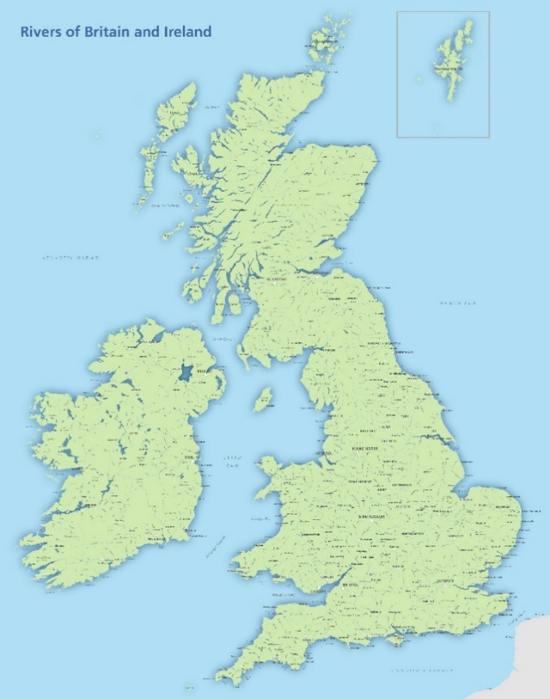
… lead to what is called the border down the
Irish Sea

Slide 18

D. Great Britain leaves EU, but Northern Ireland
stays in EU
Checks and taxes on goods and checks on people between NI and GB
But North-South border is kept free
NI staying in EU could be achieved by negotiation…
…or Irish unification
Notes:
IMAGE INSTRUCTIONS
Insert the background image as a picture.
Move, resize and crop the image to fill the entire page. As you do this, ensure the focus of your image is well positioned, ideally to the right hand side of the page.
Cut the image to the clipboard.
Right-click on the page and select Format Background.
From the Fill menu click the Picture or texture fill option and then select Clipboard. Click Close.
Go to the second part of this document to select the suitable Graphic Device for the image.
GRAPHIC DEVICE INSTRUCTIONS
Paste the Graphic Device you selected into the page.
Move and resize the circles over the points of focus in your image. Move as many circles as required to create a pleasing sense of movement.
Circles can also be resized by grabbing a corner control point. They all have their aspect ratios locked, so will resize as circles.
DO NOT delete lines or circles.
DO NOT allow the lines between the circles to cross.
Select the black or grey border and change this to match the colour of the bottom border, using colours 3, 6 or 7 in the palette.
SAVING THE FINAL IMAGE
Go to the File\Save As menu option.
Browse to your job folder and in the Save as type drop down select JPEG.
Click Save and select Current Slide Only.
The image is now ready to import into your final document.

Slide 19
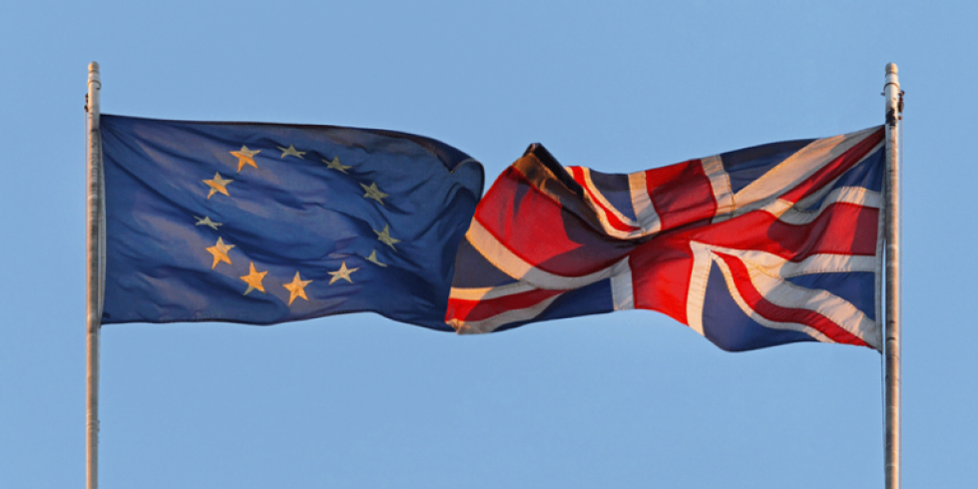
E. UK as a whole stays in the EU
The current situation: no change
Limits on movement of people from outside the EU
Checks and taxes on goods from outside the EU
Notes:
IMAGE INSTRUCTIONS
Insert the background image as a picture.
Move, resize and crop the image to fill the entire page. As you do this, ensure the focus of your image is well positioned, ideally to the right hand side of the page.
Cut the image to the clipboard.
Right-click on the page and select Format Background.
From the Fill menu click the Picture or texture fill option and then select Clipboard. Click Close.
Go to the second part of this document to select the suitable Graphic Device for the image.
GRAPHIC DEVICE INSTRUCTIONS
Paste the Graphic Device you selected into the page.
Move and resize the circles over the points of focus in your image. Move as many circles as required to create a pleasing sense of movement.
Circles can also be resized by grabbing a corner control point. They all have their aspect ratios locked, so will resize as circles.
DO NOT delete lines or circles.
DO NOT allow the lines between the circles to cross.
Select the black or grey border and change this to match the colour of the bottom border, using colours 3, 6 or 7 in the palette.
SAVING THE FINAL IMAGE
Go to the File\Save As menu option.
Browse to your job folder and in the Save as type drop down select JPEG.
Click Save and select Current Slide Only.
The image is now ready to import into your final document.

Slide 20
Summary: border implications of possible
outcomes of the Brexit process?
UK leaves EU: significantly harder north-south border
UK leaves EU, but stays in some elements of the EU such as the Single Market and/or Customs Union: harder north-south border
Great Britain leaves EU, but Northern Ireland stays in some elements of the EU such as the Single Market and/or Customs Union: harder NI-GB border
Great Britain leaves EU, but Northern Ireland stays in EU: significantly harder NI-GB border
UK as a whole stays in the EU: no change
Notes:
IMAGE INSTRUCTIONS
Insert the background image as a picture.
Move, resize and crop the image to fill the entire page. As you do this, ensure the focus of your image is well positioned, ideally to the right hand side of the page.
Cut the image to the clipboard.
Right-click on the page and select Format Background.
From the Fill menu click the Picture or texture fill option and then select Clipboard. Click Close.
Go to the second part of this document to select the suitable Graphic Device for the image.
GRAPHIC DEVICE INSTRUCTIONS
Paste the Graphic Device you selected into the page.
Move and resize the circles over the points of focus in your image. Move as many circles as required to create a pleasing sense of movement.
Circles can also be resized by grabbing a corner control point. They all have their aspect ratios locked, so will resize as circles.
DO NOT delete lines or circles.
DO NOT allow the lines between the circles to cross.
Select the black or grey border and change this to match the colour of the bottom border, using colours 3, 6 or 7 in the palette.
SAVING THE FINAL IMAGE
Go to the File\Save As menu option.
Browse to your job folder and in the Save as type drop down select JPEG.
Click Save and select Current Slide Only.
The image is now ready to import into your final document.

Slide 21
If any of these outcomes affected the border
between Northern Ireland and the Republic
of Ireland,
how would you feel about it?
If the border remained as it is today, with free movement of people and goods?
If there were minor changes, like the addition of cameras, or very rare checks?
If there were permanent checkpoints that could delay your journey?
If there were permanent checkpoints manned by police or soldiers?

Slide 22
If any of these outcomes affected the border
(airports and ferry ports) between Northern
Ireland and Great Britain,
how would you feel about it?
If the border remained as it is today, with free movement of people and goods?
If there were minor changes, like the addition of cameras, or very rare checks?
If there were permanent checkpoints that could delay your journey?
If there were permanent checkpoints manned by police or soldiers?

Slide 23
If anyone protested against an emerging
North/South border,
would they be supported at all?
Signing a petition
Peaceful demonstration
Protestors blocking traffic
Vandalising border technology (e.g. cameras)
Engaging in violence against persons

Slide 24
If anyone protested against an emerging border
between Northern Ireland and Great Britain,
would they be supported at all?
Signing a petition
Peaceful demonstration
Protestors blocking traffic
Vandalising border technology (e.g. cameras)
Engaging in violence against persons

Slide 25
Group Discussion

Slide 26
The constitutional implications
of the UK’s vote to leave the EU
Brendan O’Leary

Slide 27
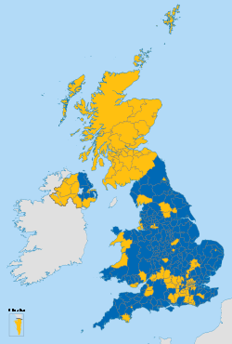
The 2016 EU referendum outcomes
Units | Leave % | Remain %
UK & Gibraltar | 51.9 | 48.1
England | 53.4 | 46.6
Wales | 52.5 | 47.5
Northern Ireland | 44.2 | 55.8
Scotland | 38.0 | 62.0
Gibraltar | 4.1 | 95.9
Notes:
IMAGE INSTRUCTIONS
Insert the background image as a picture.
Move, resize and crop the image to fill the entire page. As you do this, ensure the focus of your image is well positioned, ideally to the right hand side of the page.
Cut the image to the clipboard.
Right-click on the page and select Format Background.
From the Fill menu click the Picture or texture fill option and then select Clipboard. Click Close.
Go to the second part of this document to select the suitable Graphic Device for the image.
GRAPHIC DEVICE INSTRUCTIONS
Paste the Graphic Device you selected into the page.
Move and resize the circles over the points of focus in your image. Move as many circles as required to create a pleasing sense of movement.
Circles can also be resized by grabbing a corner control point. They all have their aspect ratios locked, so will resize as circles.
DO NOT delete lines or circles.
DO NOT allow the lines between the circles to cross.
Select the black or grey border and change this to match the colour of the bottom border, using colours 3, 6 or 7 in the palette.
SAVING THE FINAL IMAGE
Go to the File\Save As menu option.
Browse to your job folder and in the Save as type drop down select JPEG.
Click Save and select Current Slide Only.
The image is now ready to import into your final document.

Slide 28
Five major constitutional questions flow from the
UK’s prospective exit from the EU
  Possible future referendum on reuniting Ireland
  Possible changes to Northern Ireland’s institutions
  Possible changes to Northern Ireland–Republic of Ireland relations
  Possible changes in relations between the Great Britain & Ireland
  Protection of rights in the UK and Ireland
Notes:
IMAGE INSTRUCTIONS
Insert the background image as a picture.
Move, resize and crop the image to fill the entire page. As you do this, ensure the focus of your image is well positioned, ideally to the right hand side of the page.
Cut the image to the clipboard.
Right-click on the page and select Format Background.
From the Fill menu click the Picture or texture fill option and then select Clipboard. Click Close.
Go to the second part of this document to select the suitable Graphic Device for the image.
GRAPHIC DEVICE INSTRUCTIONS
Paste the Graphic Device you selected into the page.
Move and resize the circles over the points of focus in your image. Move as many circles as required to create a pleasing sense of movement.
Circles can also be resized by grabbing a corner control point. They all have their aspect ratios locked, so will resize as circles.
DO NOT delete lines or circles.
DO NOT allow the lines between the circles to cross.
Select the black or grey border and change this to match the colour of the bottom border, using colours 3, 6 or 7 in the palette.
SAVING THE FINAL IMAGE
Go to the File\Save As menu option.
Browse to your job folder and in the Save as type drop down select JPEG.
Click Save and select Current Slide Only.
The image is now ready to import into your final document.

Slide 29
1. A referendum on staying in the UK v. re-uniting
Ireland within the EU?
1998 Belfast/Good Friday Agreement
“…recognise the legitimacy of whatever choice is freely exercised by a majority of the people of Northern Ireland with regard to its status, whether they prefer to continue to support the Union with Great Britain or a sovereign united Ireland”
Given that the UK’s exit from the EU will change matters should there be a referendum on whether Northern Ireland should remain in the UK or reunite Ireland? And if so, when?
Arguments in favour? Arguments against?
Should there be a referendum
  In 2021 (when the UK will effectively leave)
  or in 2031 (ten years after)?
Notes:
IMAGE INSTRUCTIONS
Insert the background image as a picture.
Move, resize and crop the image to fill the entire page. As you do this, ensure the focus of your image is well positioned, ideally to the right hand side of the page.
Cut the image to the clipboard.
Right-click on the page and select Format Background.
From the Fill menu click the Picture or texture fill option and then select Clipboard. Click Close.
Go to the second part of this document to select the suitable Graphic Device for the image.
GRAPHIC DEVICE INSTRUCTIONS
Paste the Graphic Device you selected into the page.
Move and resize the circles over the points of focus in your image. Move as many circles as required to create a pleasing sense of movement.
Circles can also be resized by grabbing a corner control point. They all have their aspect ratios locked, so will resize as circles.
DO NOT delete lines or circles.
DO NOT allow the lines between the circles to cross.
Select the black or grey border and change this to match the colour of the bottom border, using colours 3, 6 or 7 in the palette.
SAVING THE FINAL IMAGE
Go to the File\Save As menu option.
Browse to your job folder and in the Save as type drop down select JPEG.
Click Save and select Current Slide Only.
The image is now ready to import into your final document.

Slide 30
Is your attitude to a united Ireland linked to the
possible outcome of the UK’s negotiations with
the European Union?
Will you be more likely or less likely to favour a re-united Ireland if the outcome is:
    A “Hard Exit”, in which the entire UK leaves both the EU Customs Union and Single Market?
    A “Soft Exit”, in which the entire UK stays in both the EU Customs Union and/or Single Market, or one of them?
    A “Mixed Exit”, in which Great Britain leaves the EU Customs Union and the Single Market, but Northern Ireland stays in both?
    A ”Staged Exit”, in which Great Britain leaves the EU Customs Union and Single Market in 2021, and Northern Ireland leaves both, but at a later date?
Notes:
IMAGE INSTRUCTIONS
Insert the background image as a picture.
Move, resize and crop the image to fill the entire page. As you do this, ensure the focus of your image is well positioned, ideally to the right hand side of the page.
Cut the image to the clipboard.
Right-click on the page and select Format Background.
From the Fill menu click the Picture or texture fill option and then select Clipboard. Click Close.
Go to the second part of this document to select the suitable Graphic Device for the image.
GRAPHIC DEVICE INSTRUCTIONS
Paste the Graphic Device you selected into the page.
Move and resize the circles over the points of focus in your image. Move as many circles as required to create a pleasing sense of movement.
Circles can also be resized by grabbing a corner control point. They all have their aspect ratios locked, so will resize as circles.
DO NOT delete lines or circles.
DO NOT allow the lines between the circles to cross.
Select the black or grey border and change this to match the colour of the bottom border, using colours 3, 6 or 7 in the palette.
SAVING THE FINAL IMAGE
Go to the File\Save As menu option.
Browse to your job folder and in the Save as type drop down select JPEG.
Click Save and select Current Slide Only.
The image is now ready to import into your final document.

Slide 31
To what extent is your attitude to a re-united
Ireland dependent on what it might look like?
If a re-united united Ireland looks like Ireland now, except taking in Northern Ireland…
  no provision for a regional government and parliament in Belfast/Stormont
  no provision for obligatory power sharing
If ‘Northern Ireland’ remains a distinct regional part of a united Ireland…
  a regional government and parliament in Belfast/Stormont and with current power sharing arrangements
If Ireland was re-made as a federation, based on…
  Two units : Northern Ireland and existing Ireland
  The four historic provinces of Ireland: Ulster, Connaught, Munster and Leinster
  A larger number of regions, of which Northern Ireland would be one
Notes:
IMAGE INSTRUCTIONS
Insert the background image as a picture.
Move, resize and crop the image to fill the entire page. As you do this, ensure the focus of your image is well positioned, ideally to the right hand side of the page.
Cut the image to the clipboard.
Right-click on the page and select Format Background.
From the Fill menu click the Picture or texture fill option and then select Clipboard. Click Close.
Go to the second part of this document to select the suitable Graphic Device for the image.
GRAPHIC DEVICE INSTRUCTIONS
Paste the Graphic Device you selected into the page.
Move and resize the circles over the points of focus in your image. Move as many circles as required to create a pleasing sense of movement.
Circles can also be resized by grabbing a corner control point. They all have their aspect ratios locked, so will resize as circles.
DO NOT delete lines or circles.
DO NOT allow the lines between the circles to cross.
Select the black or grey border and change this to match the colour of the bottom border, using colours 3, 6 or 7 in the palette.
SAVING THE FINAL IMAGE
Go to the File\Save As menu option.
Browse to your job folder and in the Save as type drop down select JPEG.
Click Save and select Current Slide Only.
The image is now ready to import into your final document.

Slide 32
2. Institutions within Northern Ireland
1998 Belfast/Good Friday Agreement
“This agreement provides for a democratically elected Assembly in Northern Ireland which is inclusive in its membership, capable of exercising executive and legislative authority, and subject to safeguards to protect the rights and interests of all sides of the community.”
Does the UK’s departure from the EU make a Northern Ireland Executive and Assembly more/less necessary?
Does the UK’s departure from the EU make the formation of an executive more/less difficult?
Is the UK’s departure from the EU making cross- community relations more/less harmonious?
If the major parties in Northern Ireland cannot form an agreed position on the UK’s exit from the EU, should they form an executive together?
Notes:
IMAGE INSTRUCTIONS
Insert the background image as a picture.
Move, resize and crop the image to fill the entire page. As you do this, ensure the focus of your image is well positioned, ideally to the right hand side of the page.
Cut the image to the clipboard.
Right-click on the page and select Format Background.
From the Fill menu click the Picture or texture fill option and then select Clipboard. Click Close.
Go to the second part of this document to select the suitable Graphic Device for the image.
GRAPHIC DEVICE INSTRUCTIONS
Paste the Graphic Device you selected into the page.
Move and resize the circles over the points of focus in your image. Move as many circles as required to create a pleasing sense of movement.
Circles can also be resized by grabbing a corner control point. They all have their aspect ratios locked, so will resize as circles.
DO NOT delete lines or circles.
DO NOT allow the lines between the circles to cross.
Select the black or grey border and change this to match the colour of the bottom border, using colours 3, 6 or 7 in the palette.
SAVING THE FINAL IMAGE
Go to the File\Save As menu option.
Browse to your job folder and in the Save as type drop down select JPEG.
Click Save and select Current Slide Only.
The image is now ready to import into your final document.

Slide 33
Is it time to consider some changes to the
Workings of the Executive and Assembly?
Should we have some name-changes: from First Minister and deputy First Minister to the two First Ministers?
Should it be made easier to form and maintain the executive?
  Example 1: If parties don’t take their chance to choose ministerial positions then the executive will form without them anyway, thereby pressurizing them to take their positions, but allowing for the possibility of a minority government
  Example 2: Should there be a rule requiring that the executive be supported by sixty per cent of the MLAs in the Assembly in order to form, but once elected it would stay in office until the next elections?
  Example 3: Should there only be a ‘snap election’ if both the FM & DFM agree?
  Example 4: Should “doing the hokey-pokey” be outlawed?
Notes:
IMAGE INSTRUCTIONS
Insert the background image as a picture.
Move, resize and crop the image to fill the entire page. As you do this, ensure the focus of your image is well positioned, ideally to the right hand side of the page.
Cut the image to the clipboard.
Right-click on the page and select Format Background.
From the Fill menu click the Picture or texture fill option and then select Clipboard. Click Close.
Go to the second part of this document to select the suitable Graphic Device for the image.
GRAPHIC DEVICE INSTRUCTIONS
Paste the Graphic Device you selected into the page.
Move and resize the circles over the points of focus in your image. Move as many circles as required to create a pleasing sense of movement.
Circles can also be resized by grabbing a corner control point. They all have their aspect ratios locked, so will resize as circles.
DO NOT delete lines or circles.
DO NOT allow the lines between the circles to cross.
Select the black or grey border and change this to match the colour of the bottom border, using colours 3, 6 or 7 in the palette.
SAVING THE FINAL IMAGE
Go to the File\Save As menu option.
Browse to your job folder and in the Save as type drop down select JPEG.
Click Save and select Current Slide Only.
The image is now ready to import into your final document.

Slide 34
3. North-South relations
1998 Belfast/Good Friday Agreement
“…a North/South Ministerial Council to be established to bring together those with executive responsibilities in Northern Ireland and the Irish Government, to develop consultation, co-operation and action within the island of Ireland - including through implementation on an all-island and cross-border basis - on matters of mutual interest within the competence of the Administrations, North and South.”

Slide 35
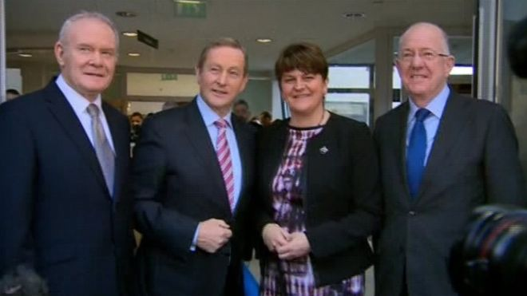
Possible changes to the North-South
ministerial council?
Should the powers of the North-South Ministerial Council be increased because cross-border political management will now be more demanding?
If the Assembly and the Executive do not function in the North, should London and Dublin ministers run the North-South Ministerial Council?
“North South Ministerial Council: Brexit dominates cross-border talks”
BBC 2016
Notes:
IMAGE INSTRUCTIONS
Insert the background image as a picture.
Move, resize and crop the image to fill the entire page. As you do this, ensure the focus of your image is well positioned, ideally to the right hand side of the page.
Cut the image to the clipboard.
Right-click on the page and select Format Background.
From the Fill menu click the Picture or texture fill option and then select Clipboard. Click Close.
Go to the second part of this document to select the suitable Graphic Device for the image.
GRAPHIC DEVICE INSTRUCTIONS
Paste the Graphic Device you selected into the page.
Move and resize the circles over the points of focus in your image. Move as many circles as required to create a pleasing sense of movement.
Circles can also be resized by grabbing a corner control point. They all have their aspect ratios locked, so will resize as circles.
DO NOT delete lines or circles.
DO NOT allow the lines between the circles to cross.
Select the black or grey border and change this to match the colour of the bottom border, using colours 3, 6 or 7 in the palette.
SAVING THE FINAL IMAGE
Go to the File\Save As menu option.
Browse to your job folder and in the Save as type drop down select JPEG.
Click Save and select Current Slide Only.
The image is now ready to import into your final document.

Slide 36
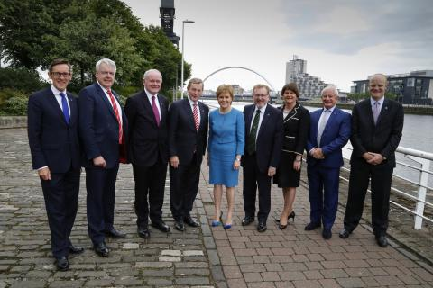
4. East-West relations between Ireland and
Great Britain
1998 Belfast/Good Friday Agreement
“A British-Irish Council (BIC) will be established under a new British Irish Agreement to promote the harmonious and mutually beneficial development of the totality of relationships among the peoples of these islands.”
Representatives from 8 governments:
The two sovereigns: UK & Ireland
Scotland, Northern Ireland & Wales
Isle of Man, Jersey and Guernsey
2016
Notes:
IMAGE INSTRUCTIONS
Insert the background image as a picture.
Move, resize and crop the image to fill the entire page. As you do this, ensure the focus of your image is well positioned, ideally to the right hand side of the page.
Cut the image to the clipboard.
Right-click on the page and select Format Background.
From the Fill menu click the Picture or texture fill option and then select Clipboard. Click Close.
Go to the second part of this document to select the suitable Graphic Device for the image.
GRAPHIC DEVICE INSTRUCTIONS
Paste the Graphic Device you selected into the page.
Move and resize the circles over the points of focus in your image. Move as many circles as required to create a pleasing sense of movement.
Circles can also be resized by grabbing a corner control point. They all have their aspect ratios locked, so will resize as circles.
DO NOT delete lines or circles.
DO NOT allow the lines between the circles to cross.
Select the black or grey border and change this to match the colour of the bottom border, using colours 3, 6 or 7 in the palette.
SAVING THE FINAL IMAGE
Go to the File\Save As menu option.
Browse to your job folder and in the Save as type drop down select JPEG.
Click Save and select Current Slide Only.
The image is now ready to import into your final document.

Slide 37
East-West relations between Ireland and
Great Britain…
Should the British Irish Council have any role in determining changes to:
  the common travel area
  movement of goods, services, and capital?
Will the UK’s departure from the EU negatively/positively impact upon the relationships among peoples of these islands?
Does a ‘hard exit’ by the UK from the EU make Scotland’s possible departure from Great Britain more likely, and, if so, would that be good or bad for Northern Ireland?
Notes:
IMAGE INSTRUCTIONS
Insert the background image as a picture.
Move, resize and crop the image to fill the entire page. As you do this, ensure the focus of your image is well positioned, ideally to the right hand side of the page.
Cut the image to the clipboard.
Right-click on the page and select Format Background.
From the Fill menu click the Picture or texture fill option and then select Clipboard. Click Close.
Go to the second part of this document to select the suitable Graphic Device for the image.
GRAPHIC DEVICE INSTRUCTIONS
Paste the Graphic Device you selected into the page.
Move and resize the circles over the points of focus in your image. Move as many circles as required to create a pleasing sense of movement.
Circles can also be resized by grabbing a corner control point. They all have their aspect ratios locked, so will resize as circles.
DO NOT delete lines or circles.
DO NOT allow the lines between the circles to cross.
Select the black or grey border and change this to match the colour of the bottom border, using colours 3, 6 or 7 in the palette.
SAVING THE FINAL IMAGE
Go to the File\Save As menu option.
Browse to your job folder and in the Save as type drop down select JPEG.
Click Save and select Current Slide Only.
The image is now ready to import into your final document.

Slide 38
5. The protection of rights
1998 Belfast/Good Friday Agreement
“The parties affirm their commitment to the mutual respect, the civil rights and the religious liberties of everyone in the community.”
Should Northern Ireland remain under the jurisdiction of the Court of Justice of the European Union as regards anti-discrimination law and employment rights?
In leaving the EU, should the UK government pledge to remain within the jurisdiction of the European Court of Human Rights and Freedoms regarding Northern Ireland (as currently under the Belfast/GFA Agreement?
Even though the UK is leaving the EU should the UK and Irish governments pledge to maintain equivalent standards or human rights, minority rights, and religious freedoms in both parts of Ireland?
Should Irish citizens in Northern Ireland retain the right to vote for Members of the European Parliament?
Notes:
IMAGE INSTRUCTIONS
Insert the background image as a picture.
Move, resize and crop the image to fill the entire page. As you do this, ensure the focus of your image is well positioned, ideally to the right hand side of the page.
Cut the image to the clipboard.
Right-click on the page and select Format Background.
From the Fill menu click the Picture or texture fill option and then select Clipboard. Click Close.
Go to the second part of this document to select the suitable Graphic Device for the image.
GRAPHIC DEVICE INSTRUCTIONS
Paste the Graphic Device you selected into the page.
Move and resize the circles over the points of focus in your image. Move as many circles as required to create a pleasing sense of movement.
Circles can also be resized by grabbing a corner control point. They all have their aspect ratios locked, so will resize as circles.
DO NOT delete lines or circles.
DO NOT allow the lines between the circles to cross.
Select the black or grey border and change this to match the colour of the bottom border, using colours 3, 6 or 7 in the palette.
SAVING THE FINAL IMAGE
Go to the File\Save As menu option.
Browse to your job folder and in the Save as type drop down select JPEG.
Click Save and select Current Slide Only.
The image is now ready to import into your final document.

Slide 39
Group Discussion

Slide 40
Live Polling

Slide 41

How the live polling works
Access our Meetoo polling software in one of two ways:
Download the app on your phone or tablet
OR
Use the following link through your phone/tablet’s browser https://web.meetoo.io/
Enter the Meeting ID: 130-000-480
Notes:
IMAGE INSTRUCTIONS
Insert the background image as a picture.
Move, resize and crop the image to fill the entire page. As you do this, ensure the focus of your image is well positioned, ideally to the right hand side of the page.
Cut the image to the clipboard.
Right-click on the page and select Format Background.
From the Fill menu click the Picture or texture fill option and then select Clipboard. Click Close.
Go to the second part of this document to select the suitable Graphic Device for the image.
GRAPHIC DEVICE INSTRUCTIONS
Paste the Graphic Device you selected into the page.
Move and resize the circles over the points of focus in your image. Move as many circles as required to create a pleasing sense of movement.
Circles can also be resized by grabbing a corner control point. They all have their aspect ratios locked, so will resize as circles.
DO NOT delete lines or circles.
DO NOT allow the lines between the circles to cross.
Select the black or grey border and change this to match the colour of the bottom border, using colours 3, 6 or 7 in the palette.
SAVING THE FINAL IMAGE
Go to the File\Save As menu option.
Browse to your job folder and in the Save as type drop down select JPEG.
Click Save and select Current Slide Only.
The image is now ready to import into your final document.

Slide 42

On the question of whether the
UK should
Leave the EU or
Remain in the EU...
POLL OPEN
30
1.
I have become more in favour of Leaving the EU
0%
2.
I have not changed my mind
0%
3.
I have become more in favour of Remaining in the EU
0%
Vote Trigger

Slide 43
On the question of a possible referendum on whether
Northern Ireland should stay in the
UK or re-unify with the rest of Ireland...
POLL OPEN
30
1.
I have become more in favour of having a referendum
0%
2.
I have not changed my mind
0%
3.
I have become more opposed to having a referendum
0%
Vote Trigger

Slide 44
On the question of how to vote if there was a referendum on a United Ireland...
POLL OPEN
30
1.
I have become more in favour of Northern Ireland staying in the UK
0%
2.
I have not changed my mind
0%
3.
I have become more in favour of a united Ireland
0%
Vote Trigger

Slide 45
"I changed my views as a result of the table discussions"
POLL OPEN
30
1.
Agree
0%
2.
Neither agree nor disagree
0%
3.
Disagree
0%
Vote Trigger

Slide 46
And finally, if there was to be a leadership election in the
Conservative party in the coming months, who would you choose to take over as Conservative party leader and
Prime Minister of the
United Kingdom?
POLL OPEN
30
1.
Theresa May
0%
2.
Boris Johnson
0%
3.
Philip Hammond
0%
4.
Jacob Rees-Mogg
0%
5.
None of these
0%
6.
I don’t know
0%
Vote Trigger

Slide 47
Thank you

