Slide 1
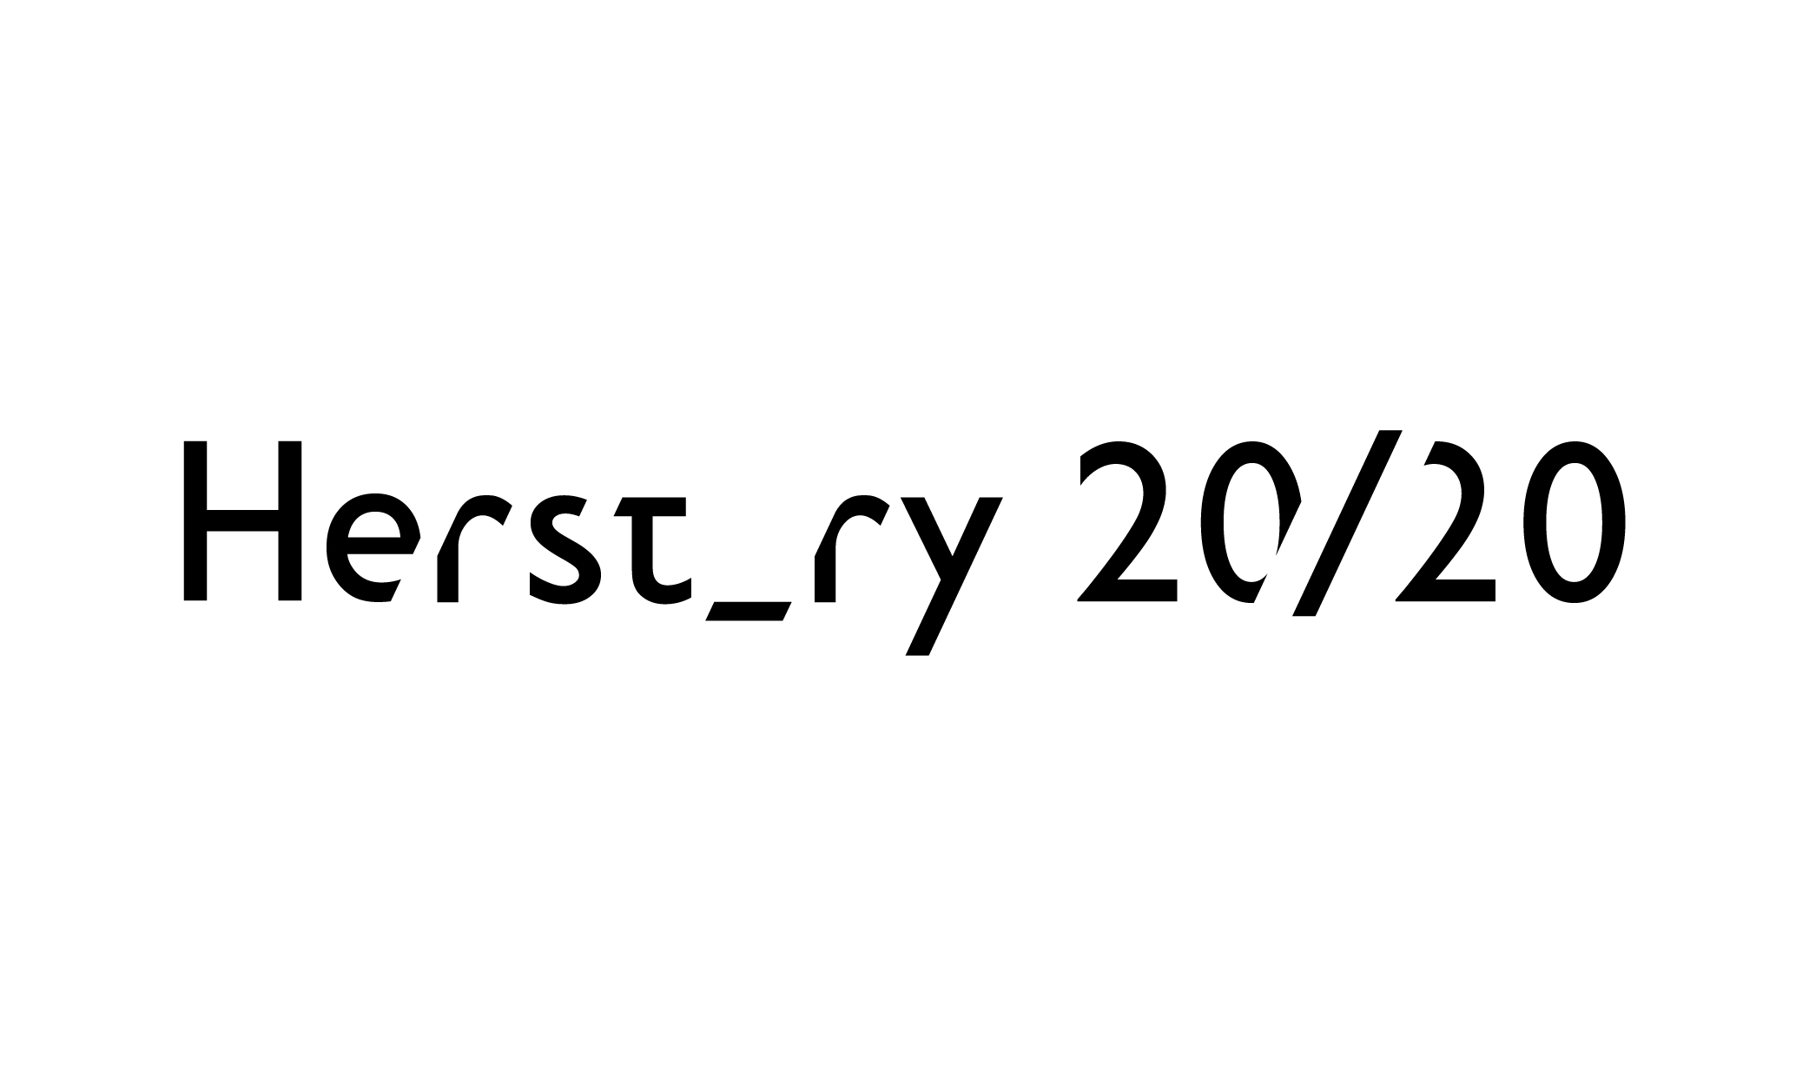

Queen’s Gender Initiative
WOMEN IN QUEEN’S PORTRAITS
#HerstoryRTE

Slide 2
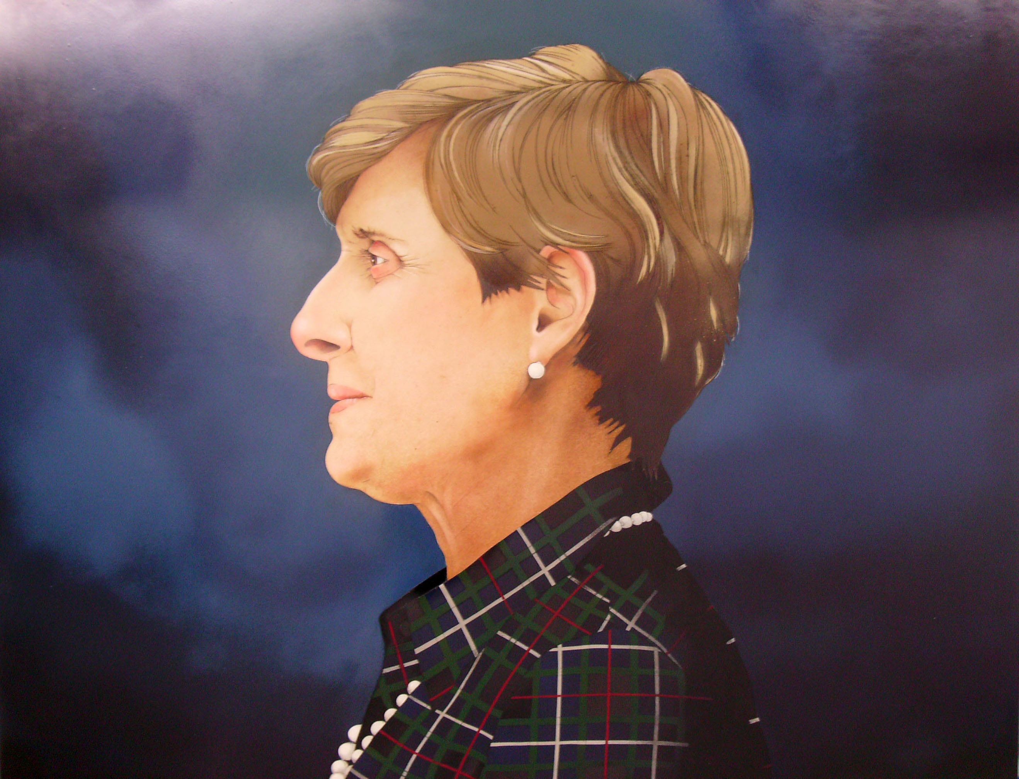
Professor Elizabeth Meehan
Artist: john kindness
Queen’s Gender Initiative
WOMEN IN QUEEN’S PORTRAITS
#HerstoryRTE

Slide 3
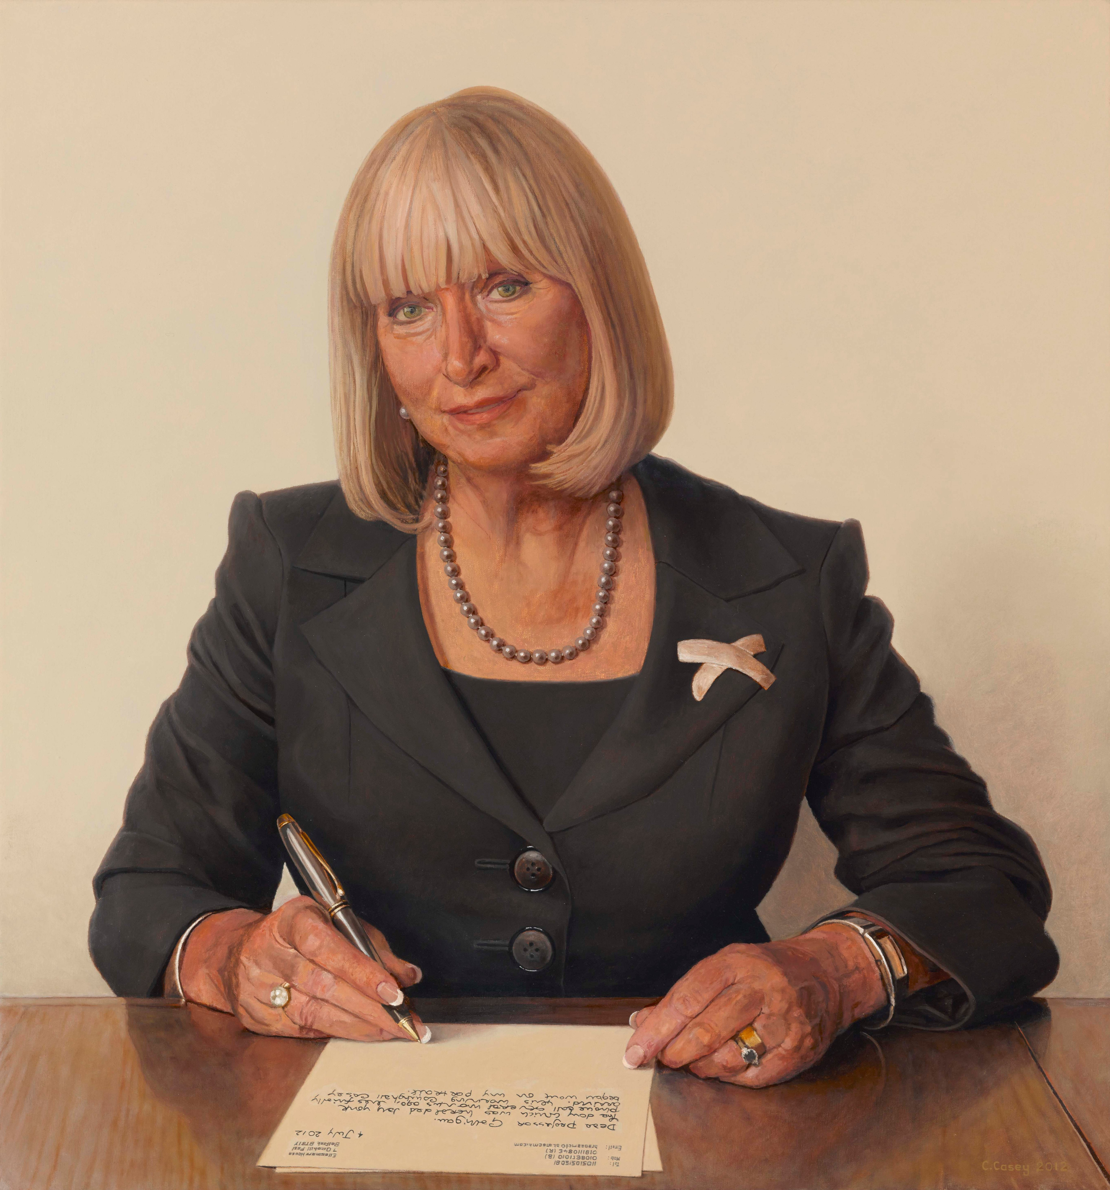
Mrs Brenda McLaughlin Pro Chancellor
Artist: Comhghall Casey
Queen’s Gender Initiative
WOMEN IN QUEEN’S PORTRAITS
#HerstoryRTE

Slide 4
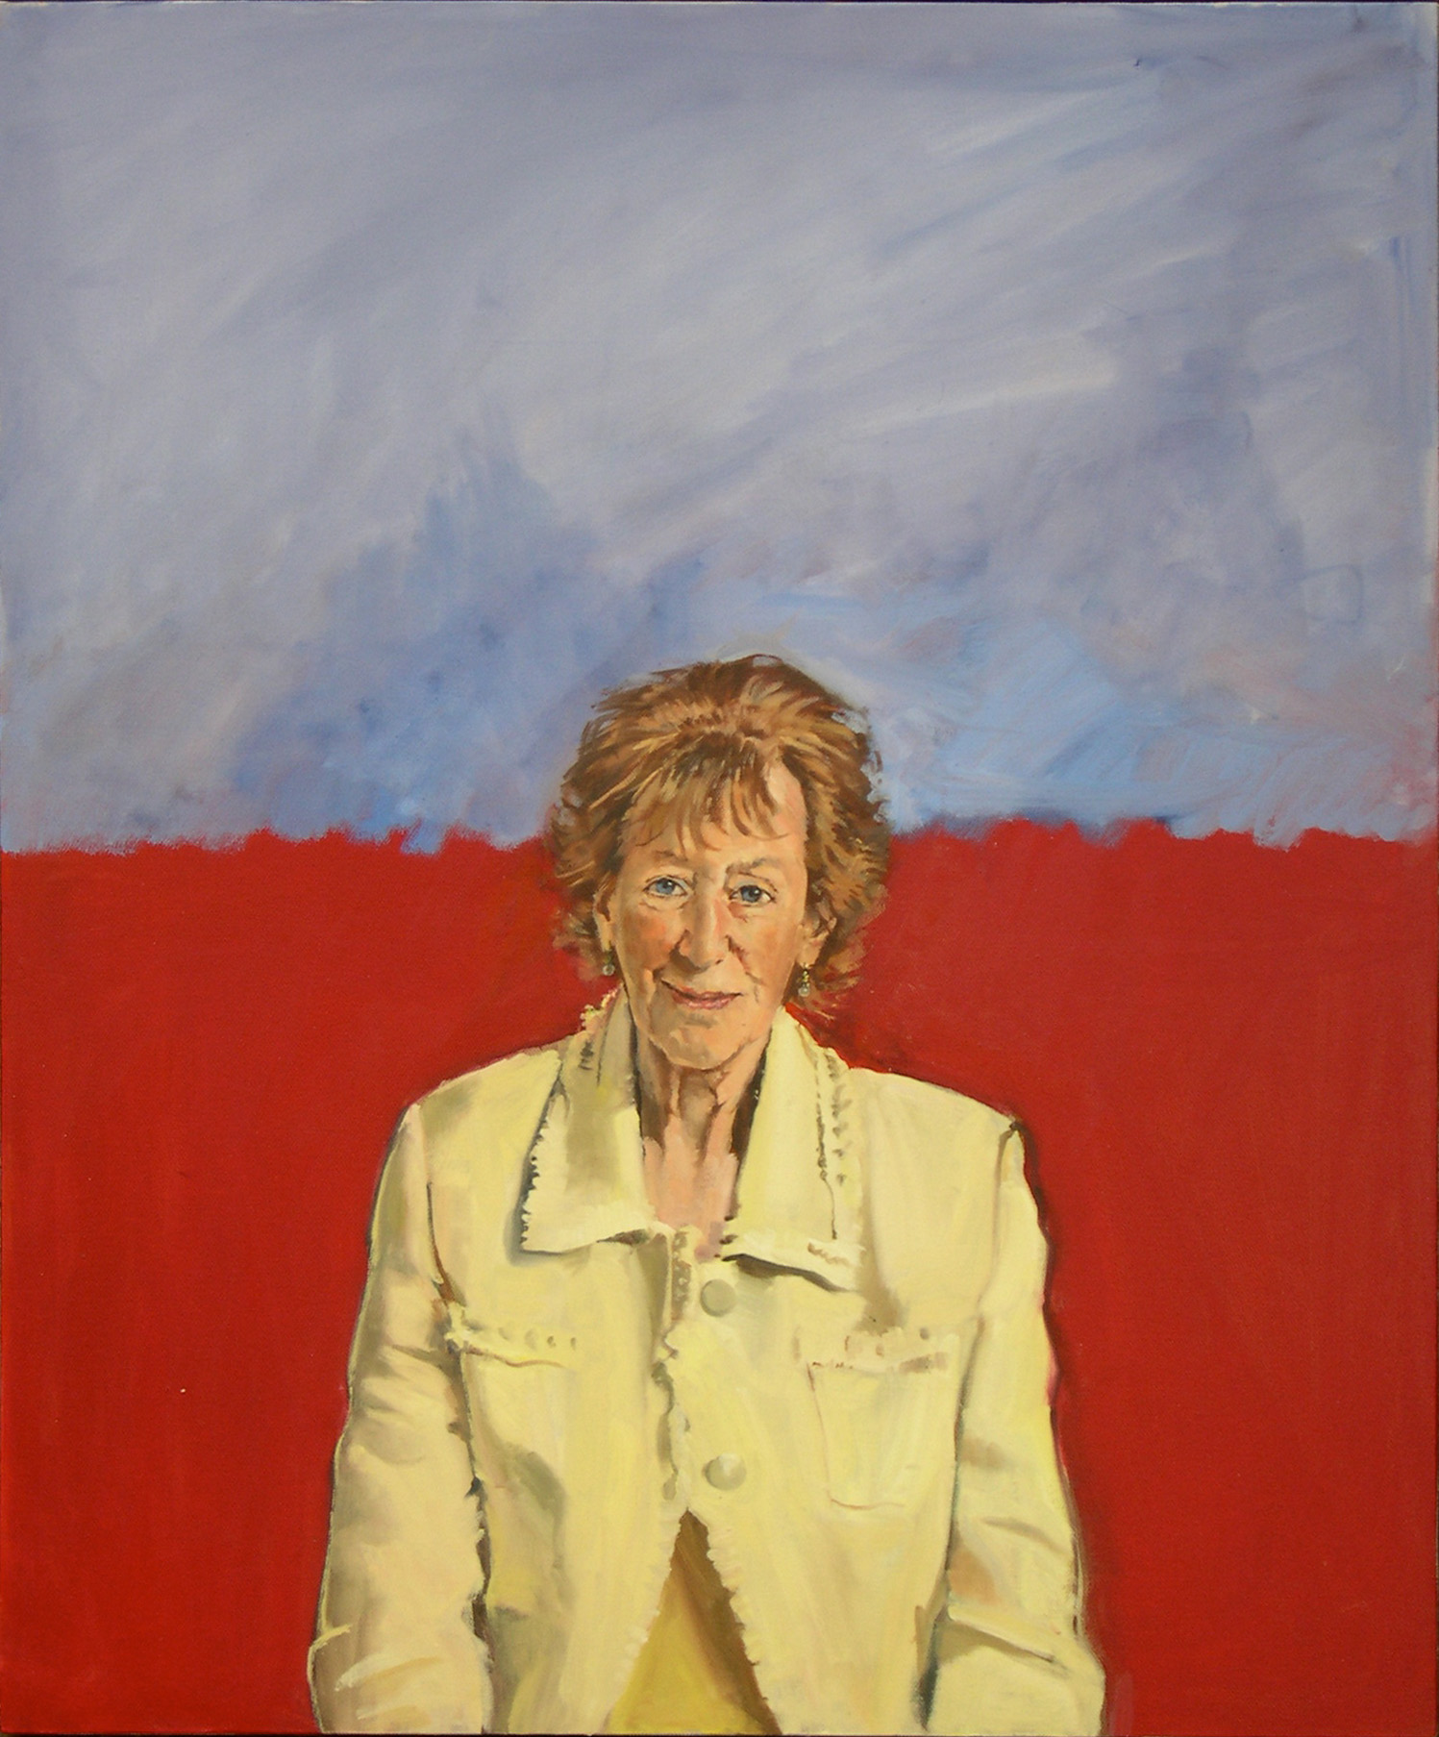
Professor Dame Ingrid Allen
Artist: Tom Hallifax
Queen’s Gender Initiative
WOMEN IN QUEEN’S PORTRAITS
#HerstoryRTE

Slide 5
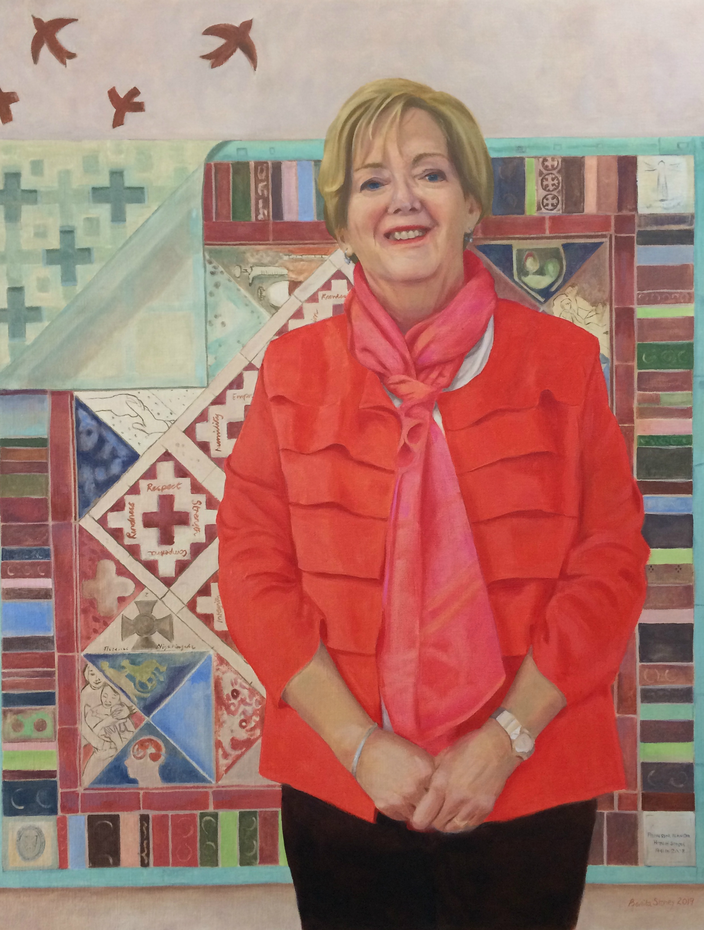
Professor Jean Orr
Artist: Benita Stoney
Queen’s Gender Initiative
WOMEN IN QUEEN’S PORTRAITS
#HerstoryRTE

Slide 6
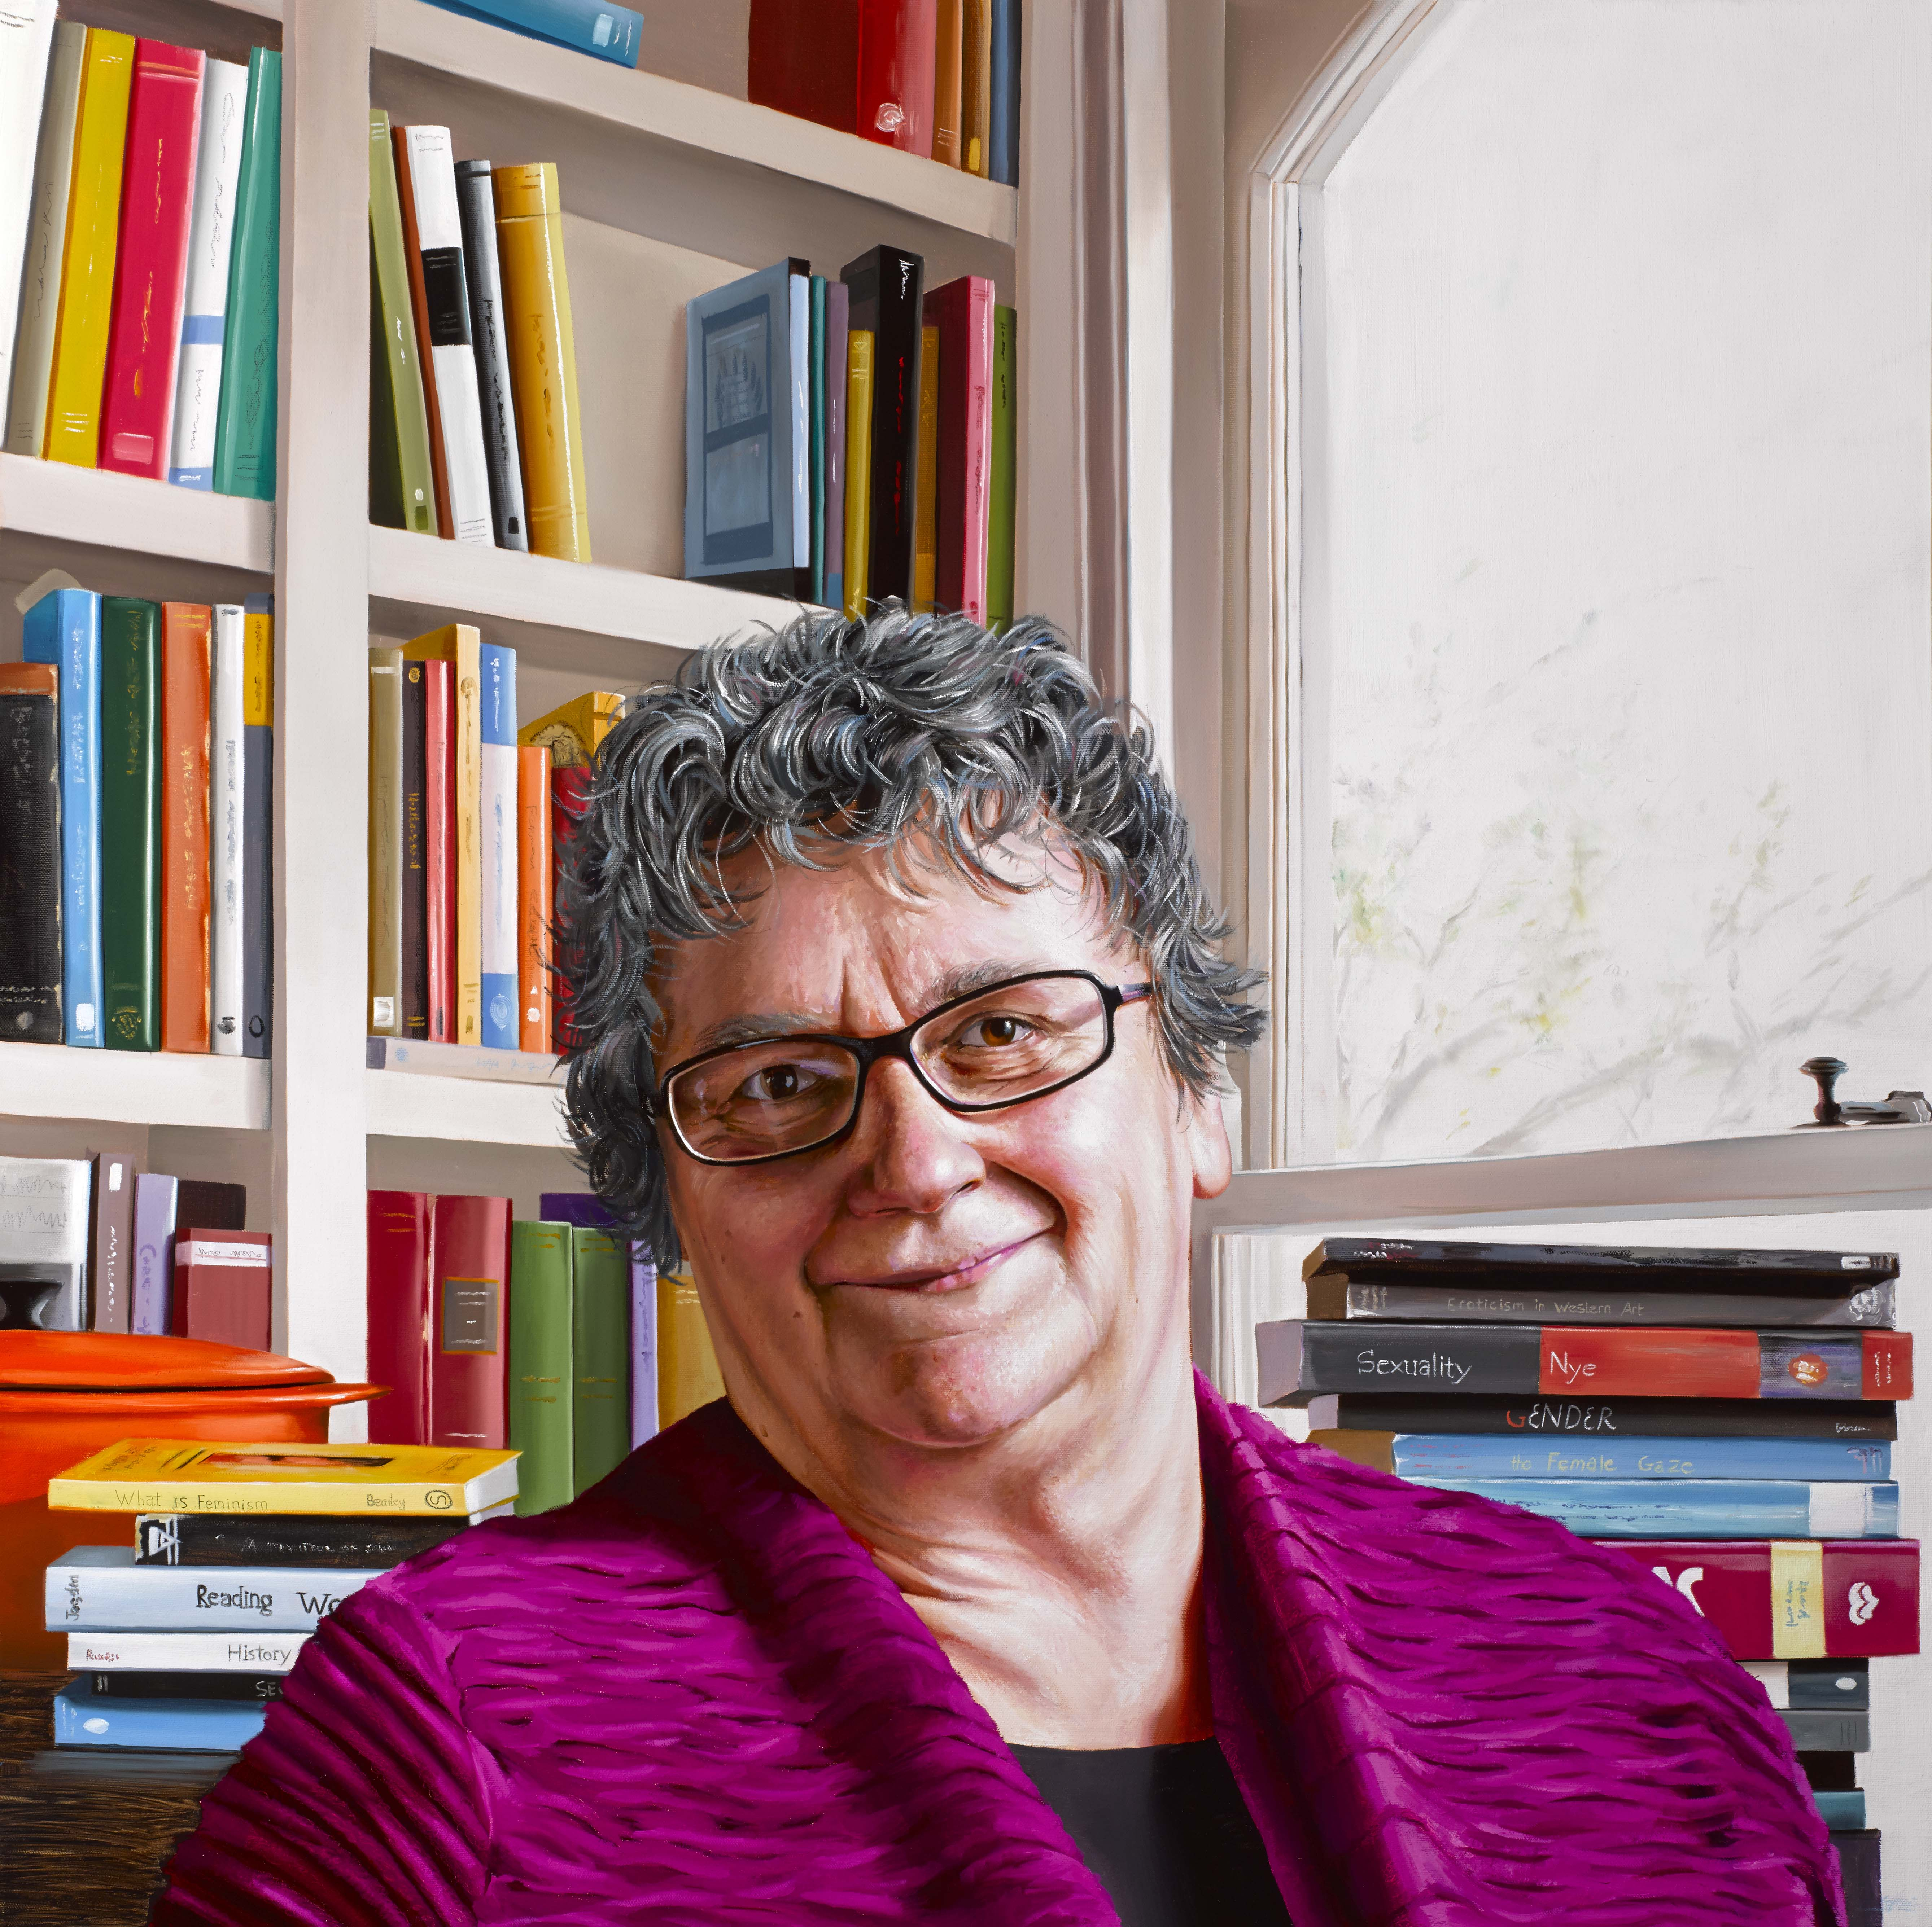
Professor Margaret Mullett
Artist: Stephen Johnston
Queen’s Gender Initiative
WOMEN IN QUEEN’S PORTRAITS
#HerstoryRTE

Slide 7
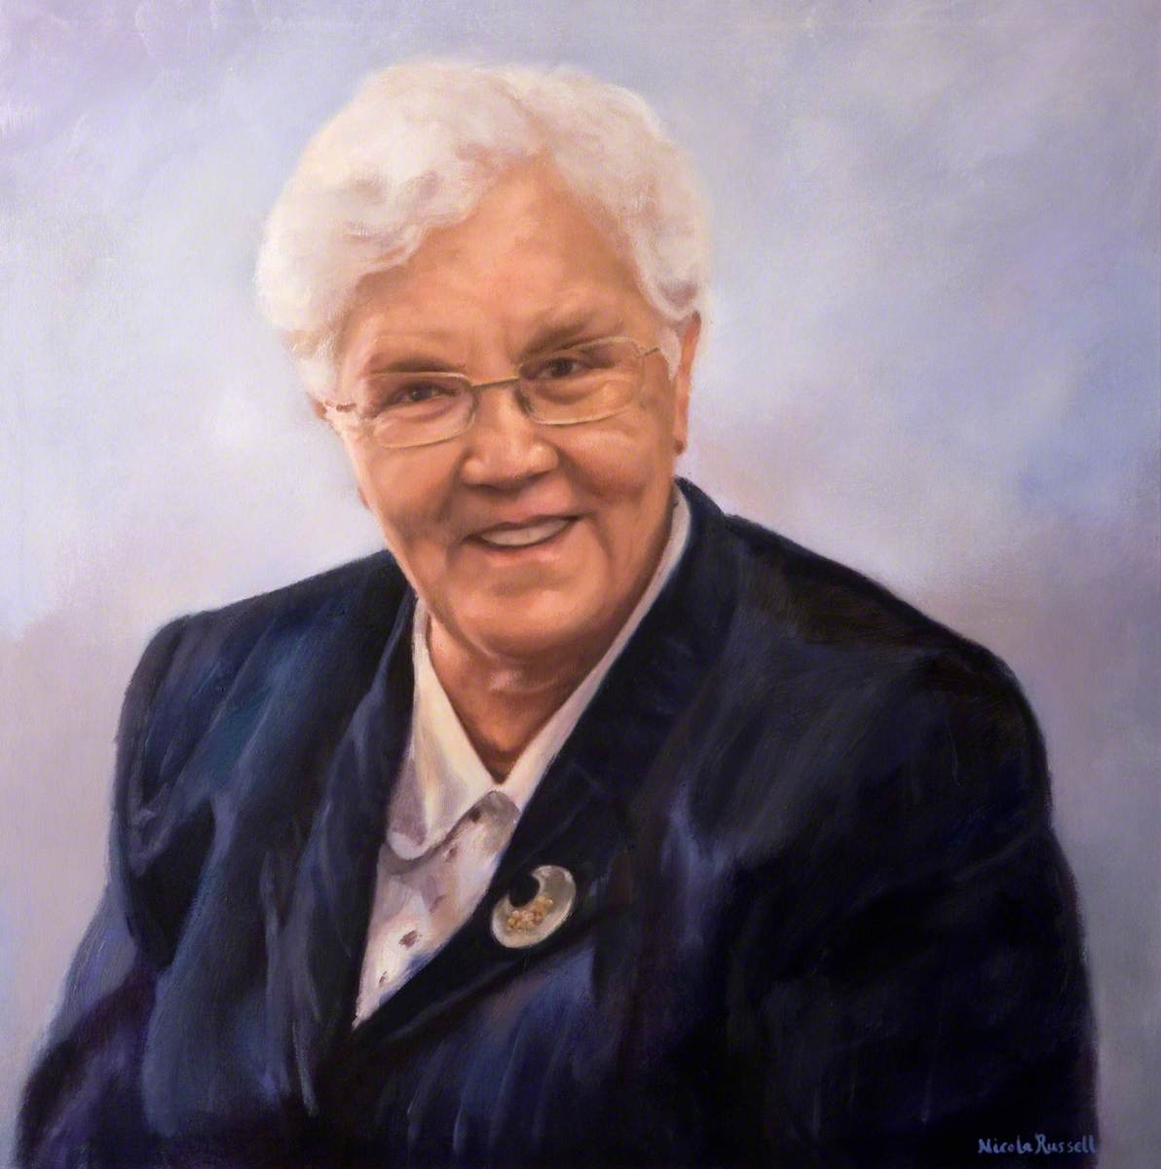
Baroness May Blood
Artist: Nicola Russell
Queen’s Gender Initiative
WOMEN IN QUEEN’S PORTRAITS
#HerstoryRTE

Slide 8
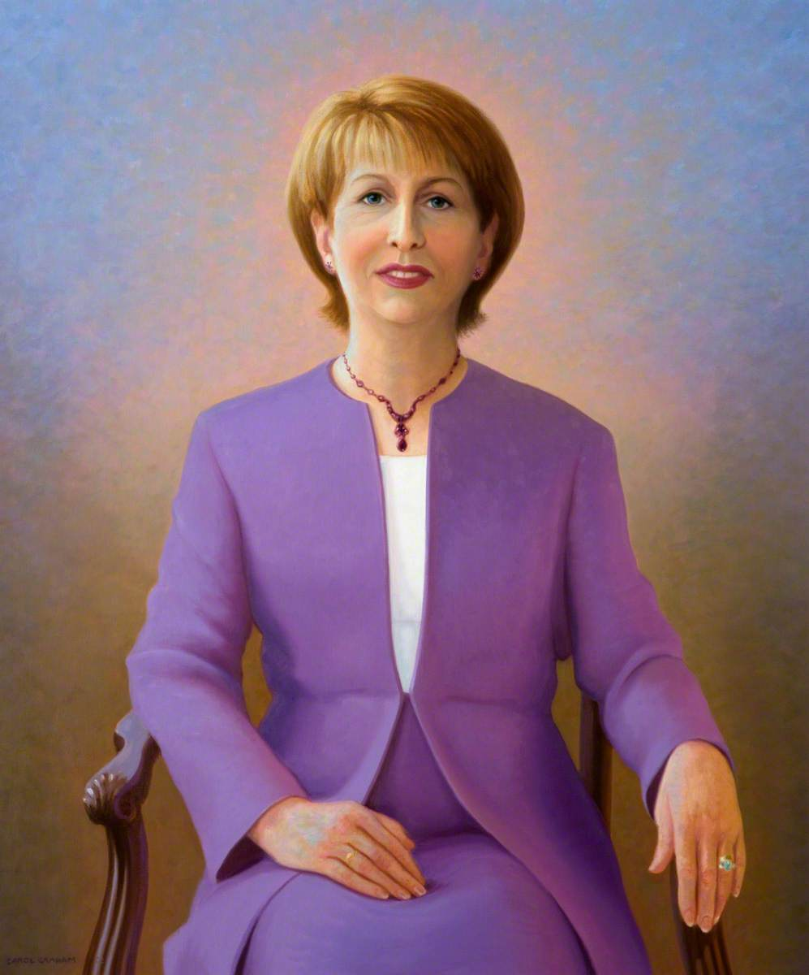
Professor Mary McAleese
Artist: Carol Graham
Queen’s Gender Initiative
WOMEN IN QUEEN’S PORTRAITS
#HerstoryRTE

Slide 9
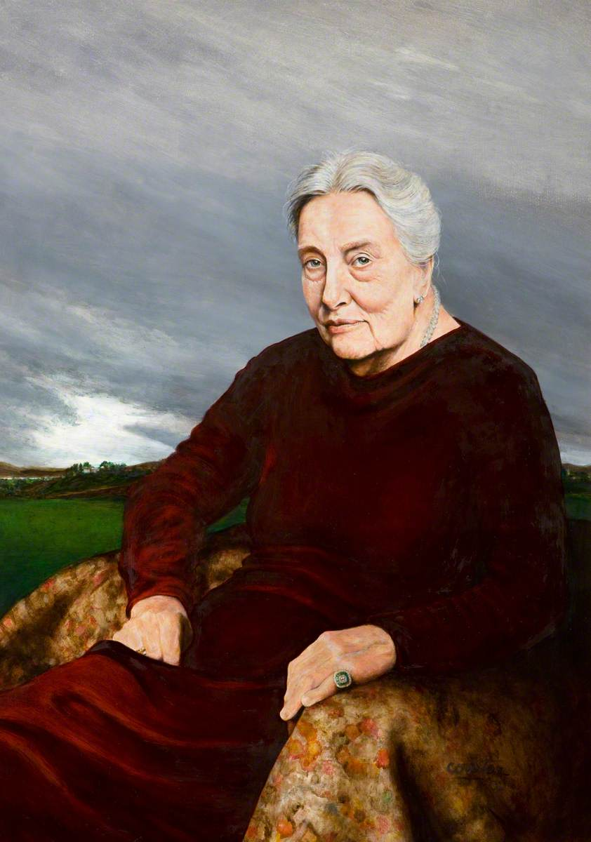
Professor Mollie McGeown
Artist: Laurence Coulter
Queen’s Gender Initiative
WOMEN IN QUEEN’S PORTRAITS
#HerstoryRTE

Slide 10
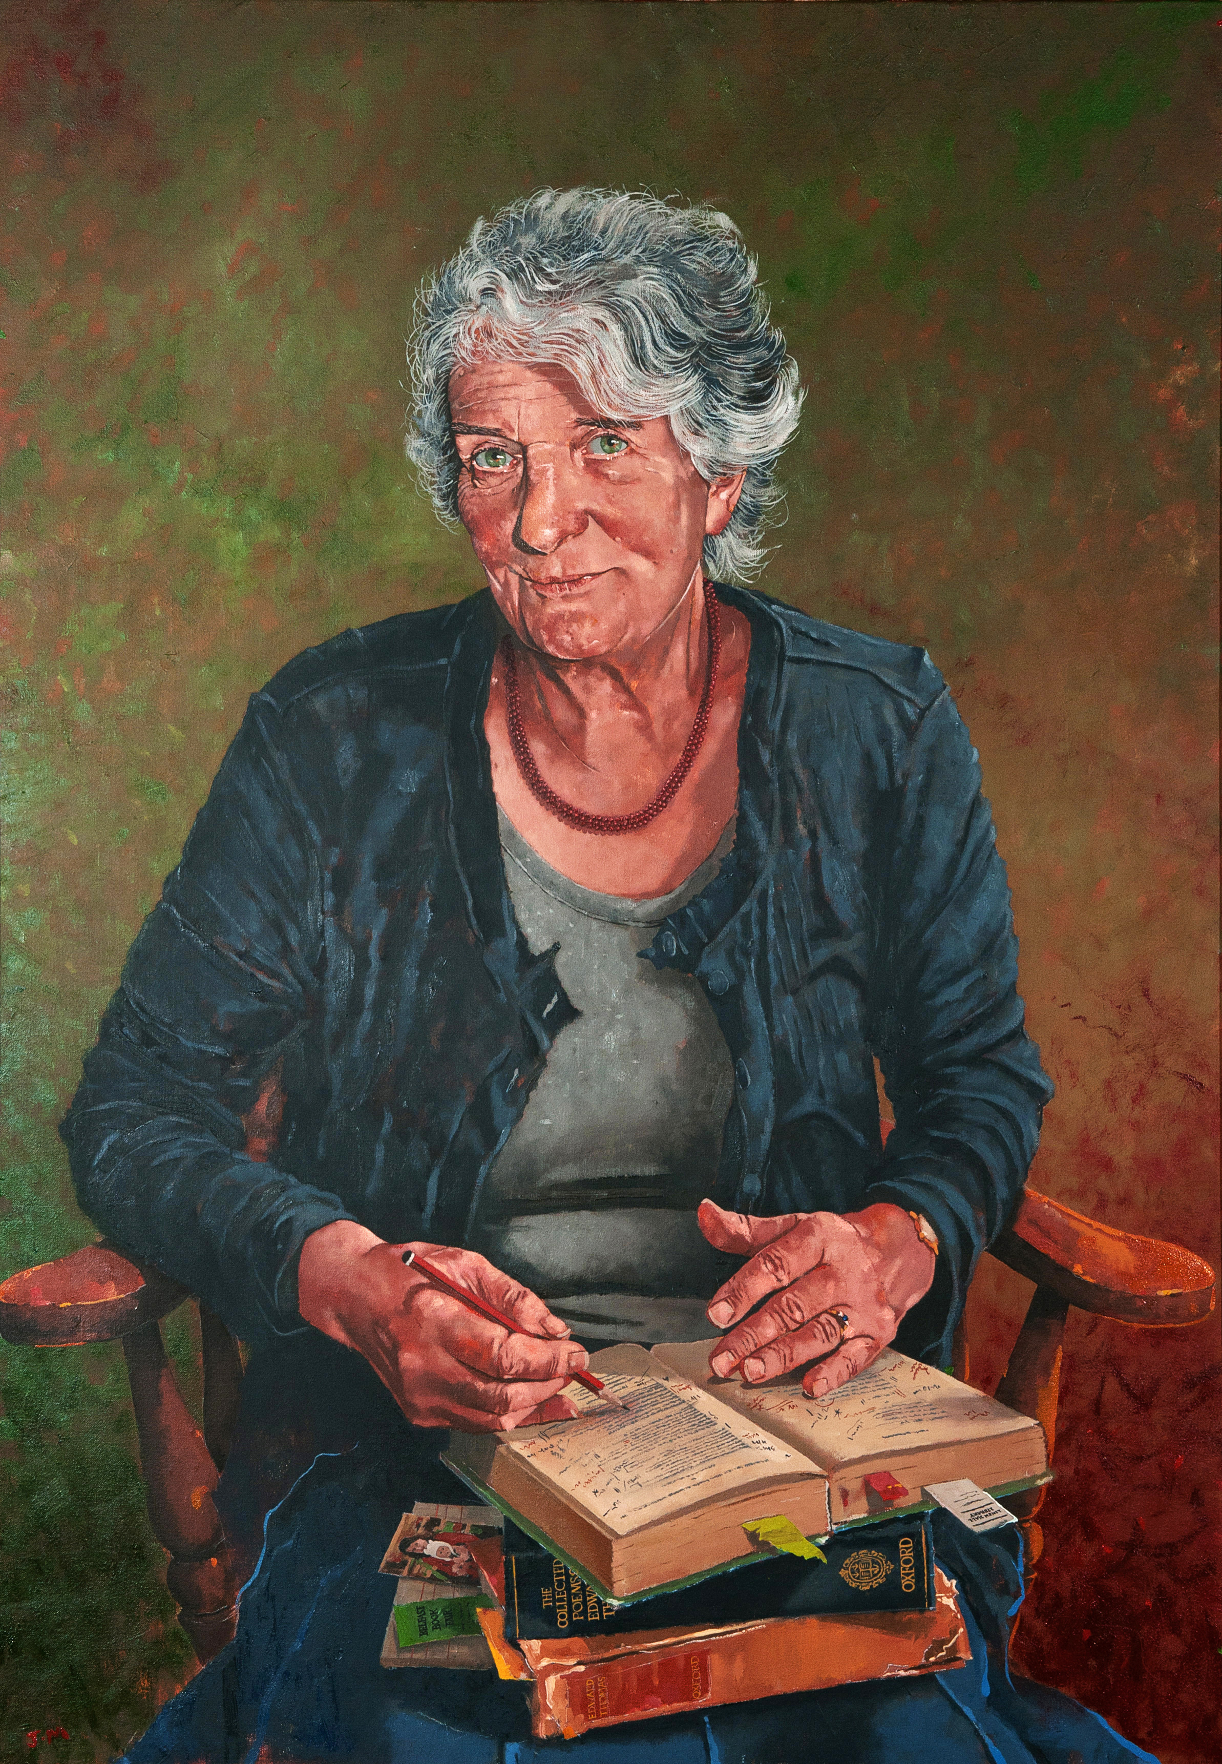
Professor Edna Longley
Artist: Jeffrey Morgan
Queen’s Gender Initiative
WOMEN IN QUEEN’S PORTRAITS
#HerstoryRTE

Slide 11
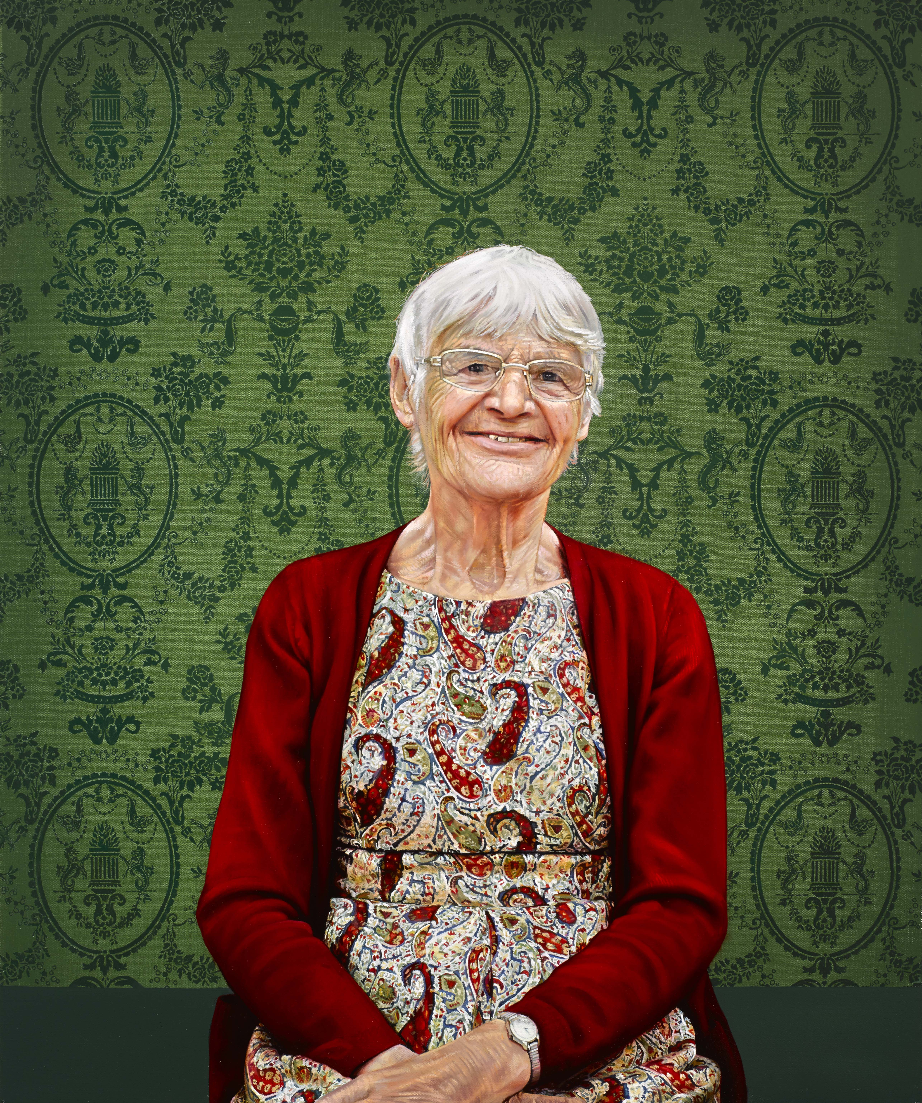
Professor Ruth Lynden-bell
Artist: Jennifer Trouton
Queen’s Gender Initiative
WOMEN IN QUEEN’S PORTRAITS
#HerstoryRTE

Slide 12
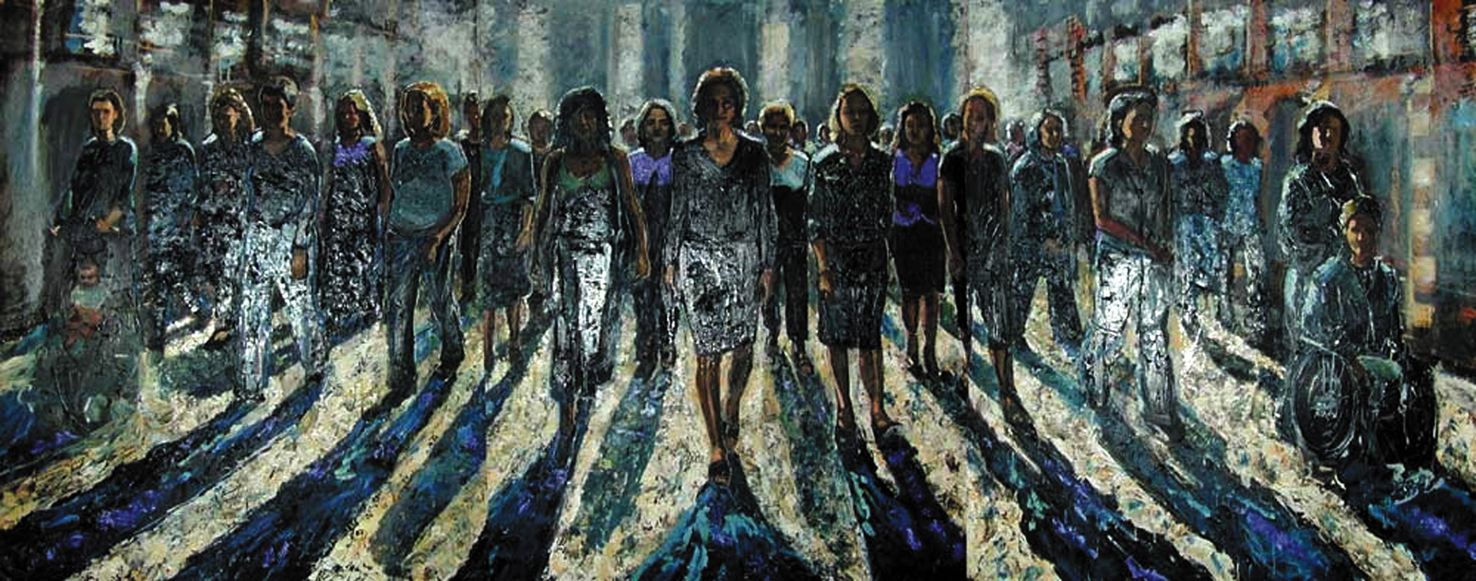
“Out of the Shadows” commissioned (2000)
Council Chamber, Queen’s University Belfast
Artist: Michelle Rogers
#HerstoryRTE

